Slide 1

Integrating Pre-Exposure
Prophylaxis (PrEP) into the
Primary Care Setting
Christine Kerr, MD
Medical Director of HIV, Hepatitis, and Specialty Care
Hudson River HealthCare
February 12, 2016

Slide 2

Why PrEP in the Primary Care Setting?
What are the challenges around PrEP in the primary care setting and how can they be addressed?
What can we do to facilitate PrEP in these settings?
What has been our experience with PrEP?
What barriers and challenges are we facing as we move forward?

Slide 3

Why PrEP in the Primary Care Setting?
Willie Sutton Model
Birth Control Model/Travel Medicine Model
Easy to do
Part of routine preventive care and adherence work
It’s already being done!

Slide 4
Ending the Epidemic
Identifying persons with HIV who remain undiagnosed and linking them to health care
Linking and retaining persons with HIV to health care, getting them on anti-HIV therapy to improve their health and prevent transmission
Providing Pre-Exposure Prophylaxis (PrEP) to high-risk persons to keep them HIV-negative.

Slide 5
Willie Sutton
Go where the money is!
  Best way to reach HIV-negative people is not to go through HIV programs!
But take the principles of talking about sex, risk, and harm reduction.

Slide 6
42% of PrEP users are women
11.5% of users are less than 25 years
  17% of women were less than 25 (vs. 7.4% of men)
J Int AIDS Soc. 2014 Nov 2;17(4 Suppl 3):19730. doi: 10.7448/IAS.17.4.19730. eCollection 2014.
Two years of Truvada for pre-exposure prophylaxis utilization in the US.
Flash C¹, Landovitz R², Giler RM³, Ng L³, Magnuson D³, Wooley SB⁴, Rawlings K⁴.
Notes:
Pharmacy level data

Slide 7
Preventing Infections:
Model 1
When you travel to parts of the world where you can get malaria…what do you do?
  You should always use bed nets and avoid mosquito exposure, so don’t leave your hotel
When you are in a behavioral or epidemiologic environment where HIV risk is high…what can you do?
  You should always use condoms for all sex all the time and only have one partner and don’t have an HIV positive partner

Slide 8
Preventing Infections:
Model 2
When you travel to parts of the world where you can get malaria…what do you do?
  Use bed nets and avoid mosquitos as much as possible
  Take anti malarial medications as pre-exposure prophylaxis
When you are in a behavioral or epidemiologic environment where HIV risk is high…what can you do?
  Always use condoms, but the reality is sometimes some people won’t do this
  Take HIV medications to prevent acquisition of HIV

Slide 9
Preventing Unplanned Consequences of Sex
Model 1:
  If a woman is not ready to get pregnant, we tell her to use condoms – they are mostly effective, they have few side effects, and can prevent some STDs
Model 2:
  Talk to her about risk reduction (choosing partner, timing), talk about condom use, talk about pharmacologic birth control
Why does taking a pill to lower risk of acquiring HIV need to be different?

Slide 10
PrEP is…
Safe
Easy
Effective
  Adherence is important; but we already talk about that…

Slide 11
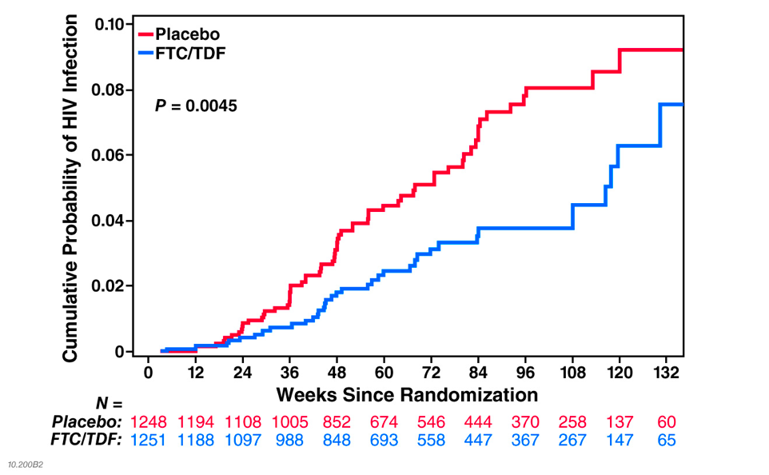
Efficacy (MITT) 44% (15-63%)
Infection Numbers: 110 in total, 10 at baseline
64 – 36 = 28 averted

Slide 12
HIV Incidence and Drug Concentrations
Follow-up % 26% 12% 21% 12%
Risk Reduction 44% 84% 100% 100%
95% CI -31 to 77% 21 to 99% 86 to 100%
(combined)
Grant WAC Melbourne 2014;
Grant et al, Lancet Infectious Diseases, published online July 22, 2014

Slide 13
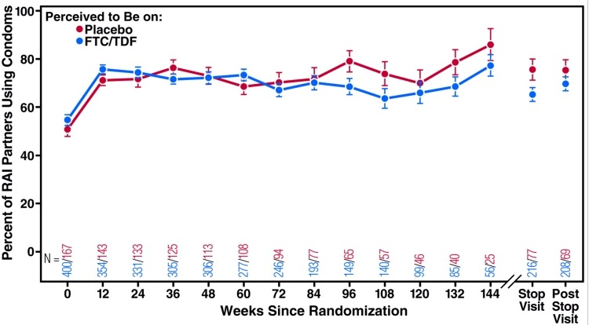
No Evidence of Risk Compensation in iPrEx Study
Marcus et al. PLoS One 2013

Slide 14
Already being done!
J Int AIDS Soc. 2014 Nov 2;17(4 Suppl 3):19730. doi: 10.7448/IAS.17.4.19730. eCollection 2014.
Two years of Truvada for pre-exposure prophylaxis utilization in the US.
Flash C¹, Landovitz R², Giler RM³, Ng L³, Magnuson D³, Wooley SB⁴, Rawlings K⁴.

Slide 15
Barriers to implementing PREP
Patient perspective
  Stigma
  Fear of being judged
  Lack of knowledge

Slide 16
Barriers to implementing PREP
Provider perspective
  Embarrassment
  Lack of knowledge
    Availability
    How to use
    Where to refer
  Fear of side effects/complications
  Fear of resistance
  Medico-legal
  Judgment

Slide 17
From focus groups with patients…
“You want to have a doctor who knows you [to get PrEP]. Then you can be more honest…He’s there for your wellbeing.”
“I’m sure if I’m like, ‘Doc, there’s something available that could prevent me from getting HIV,” he wouldn’t think twice. He’d already have his script pad out…’”
“Even getting PrEP isn’t always easy because not even a lot of doctors seem to be aware of it. I’ve talked to various doctors about it and ER doctor’s and they’re – they’re like ‘Never heard of it.’”
2014 Nov 11;9(11):e112425. doi: 10.1371/journal.pone.0112425. eCollection 2014.
Access to Healthcare, HIV/STI Testing, and Preferred Pre-Exposure Prophylaxis Providers among Men Who Have Sex with Men and Men Who Engage in Street-Based Sex Work in the US.
Underhill K1, Morrow KM2, Colleran CM2, Holcomb R3, Operario D4, Calabrese SK5, Galárraga O4, Mayer KH6.

Slide 18
From focus groups with providers…
THEMES | KEY QUOTES
There is little consensus on the target population for PrEP | This is going to be such a limited resource, that we want to make sure that it’s not necessarily going to all the worried well.
Current models of care are not always well suited for prescribing PrEP | We are not used to having people that come back for check-ins on a regular basis. We wouldn’t be able to operate it if RN’s were excluded from providing [it].
Providers need more capacity before they can prescribe PrEP | If we wanted our medical assistants or anyone to provide PREP, they would require some counseling training. So it would require some supports, both around education, around adherence, and also financially, because we have as many uninsured as we do – we’d have to have access to meds and I’m sure it’s expensive.

Slide 19
Themes, continued | Quotes
Monitoring patients on PrEP will be challenging | I think a lot of young people tend to have less stable schedules. They might take it just 3 days before an event, if they know that they’re going to have a party or something special.
PrEP has public health benefit | And so only treating the positive partner isn’t going to eliminate all the infections, and so finding the right balance between treatment and PrEP I think is important to have as a target.
2012;7(7):e40603. doi: 10.1371/journal.pone.0040603. Epub 2012 Jul 11.
A qualitative study of provider thoughts on implementing pre-exposure prophylaxis (PrEP) in clinical settings to prevent HIV infection.
Arnold EA1, Hazelton P, Lane T, Christopoulos KA, Galindo GR, Steward WT, Morin SF.

Slide 20
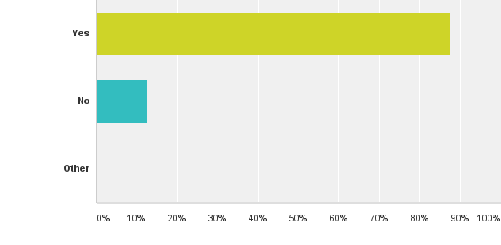
2014 - Have you heard about Pre-Exposure Prophylaxis for HIV?

Slide 21
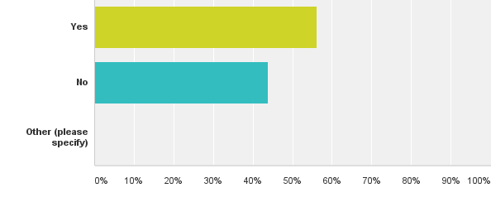
2014 - Have you heard of the New York State guidelines to prescribe PREP (www.hivguidelines.org)?

Slide 22
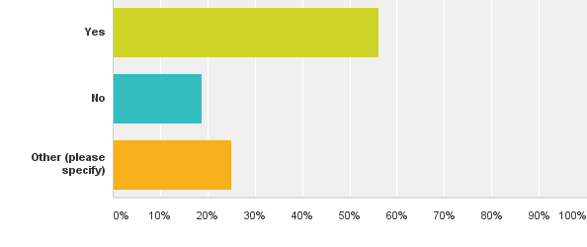
2014- Do you think you have patients who would be interested in taking medication to prevent HIV?
“Never thought about it…oops!”

Slide 23
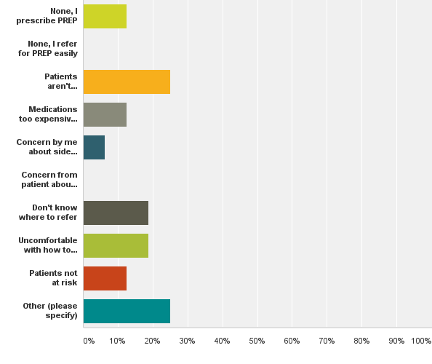
2014- What are the barriers to referring patients to PREP or to prescribing PREP?

Slide 24
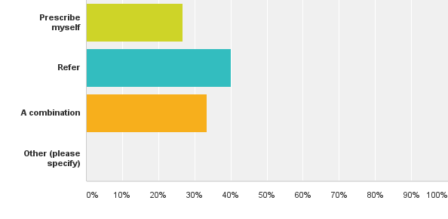
2014- Would you rather prescribe these medications yourself or refer to a specialist?

Slide 25
What can we do to facilitate use of PrEP?
Patient level outreach
Provider level outreach
Advocacy/Public Health
Notes:
Pharmacy level data

Slide 26
Our Outreach Plan
Known Serodiscordant Partners
All HIV Patients/HIV Providers
All Patients with STDs/OB-GYN
All Primary Care Patients/All Providers
Community Partners

Slide 27
Our Team
Patient and Community
PrEP Educator
Primary Care Provider
ID Specialists
Grant Administrator/Directors
HIV Team
Peers
Lab Personnel
Adherence nurses
Social Work

Slide 28
Patient Level Outreach
Clinic setting
  Brochures/posters
  Through serodiscordant partners
Patients with STIs, patients requesting HIV testing
All primary care patients (posters, flyers, ask about Hep C buttons/ask about PrEP)
Peer work
Outreach
- doh, local colleges/high schools, drug treatment centers, social media

Slide 29
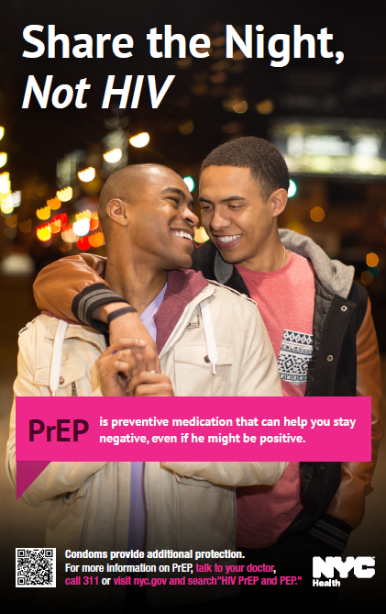
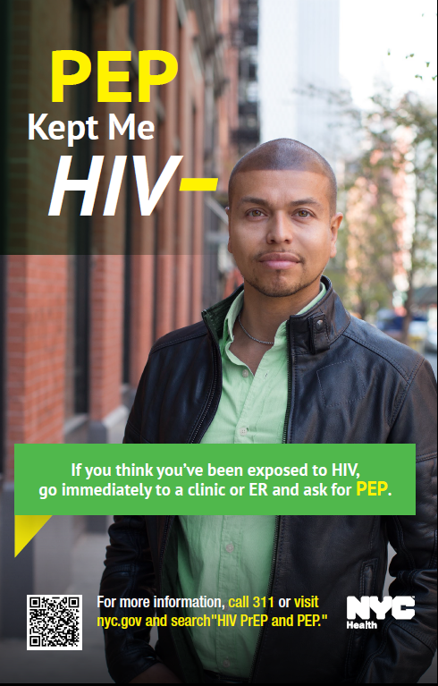
Notes:
Over 11,000 pamphlets, over 13,000 postcards, and almost 7,000 posters have been distributed to date
**rough estimate and actual numbers are likely much higher

Slide 30
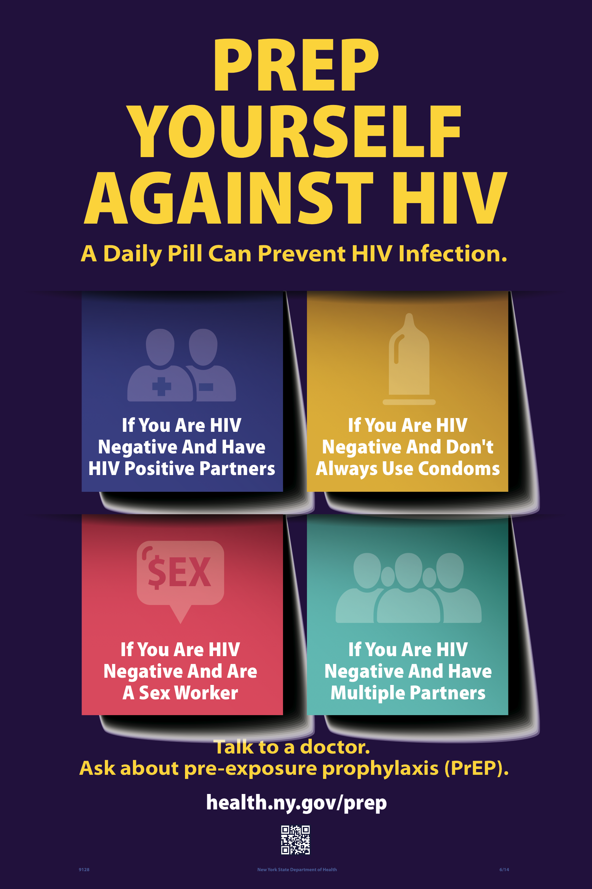

Slide 31
Provider Outreach
Our PrEP Educator Model
Speaking at “Best Practices/Grand Rounds”
Speaking at monthly staff meetings
Facilitating guidelines, order sets, and templates in eCW

Slide 32
Our solution…
PrEP Educator–
Tannya Mannain, LCSW
Now Candice Melvin, LPN – 845-260-0043
    Adherence specialist
    Responsibilities
      Patient and Provider education
        Guidelines
        Cultural competency
      Linkage to care for general sexual health
      Outreach to communities at risk
      Outreach to primary care providers
      Tracking and monitoring
        Including adherence assessments/techniques
      Prior authorizations, linkage to Patient-assistance programs
      Making appointments and follow-up

Slide 33
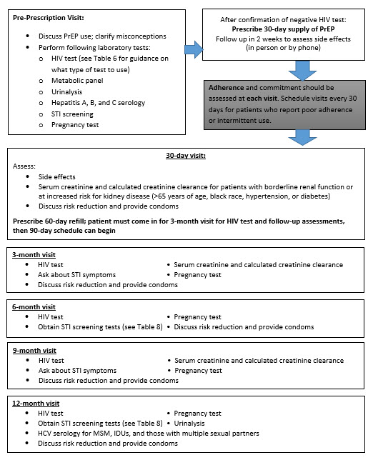

Slide 35
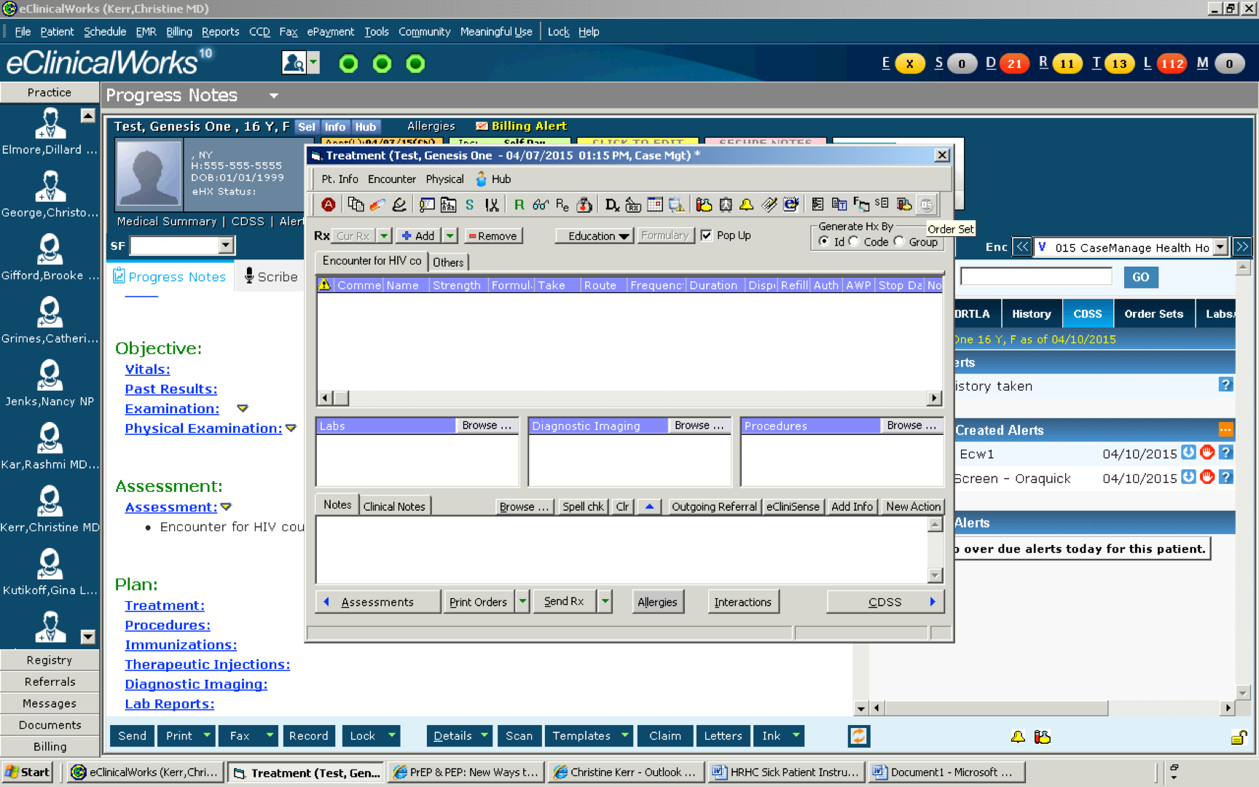

Slide 36
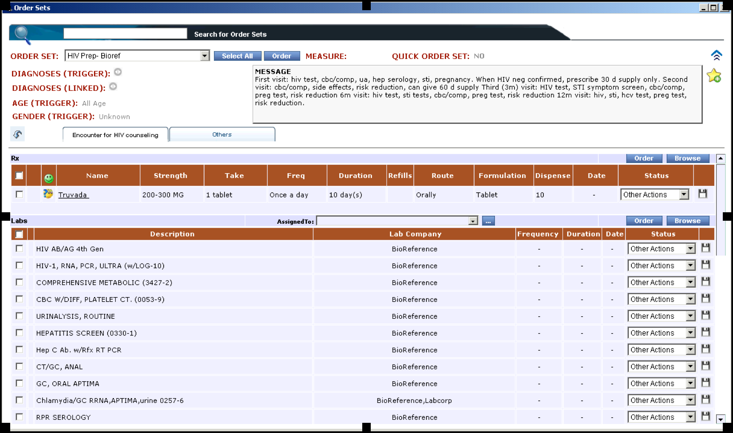

Slide 37
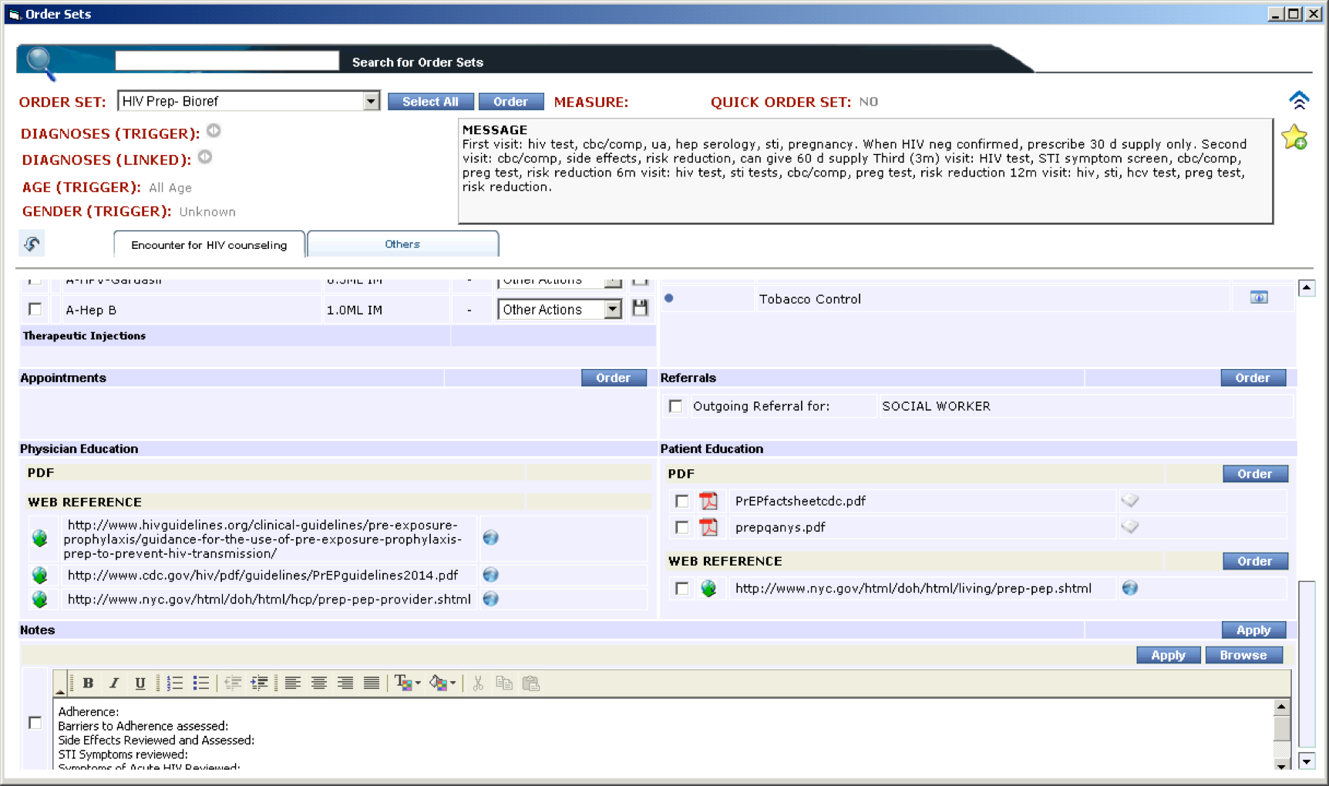

Slide 38
Issues with payment
Cost – almost $12k/year
  91% of that is drug cost
Covered by many insurances, including Medicaid
Prior auth frequently necessary
Pharma support – copay cards
  www.GileadCoPay.com or 1-877-505-6986
Lack of awareness of support from both patients and providers

Slide 39
For completely uninsured/undocumented
  Gilead Advancing Access Program
  www.pparx.com
Lab costs
Cost of visits
  Consult, 1 month, then every 3 months

Slide 40
Uninsured Lab Costs
Initial: 79.90
Monthly: 26.52
Lab test | Cost
HIV Ab/Ag 4th gen | 12.27
BMP | 7.25
RPR | 3.27
Urinalysis | 4.00
NAAT Gc/CT | 42.86
Pregnancy | 3.00
Hep Panel (A, B, C) | 7.25
HIV RNA PCR ** | 117.59

Slide 41
Current numbers at 1 yr
56 patients total for program.
  34 screened for PrEP, 2 PEP
  13 Screened and never started
  7 screened started and stopped medication
25 patients currently on within last 30 days

Slide 42
Barriers
Slow Uptake
  Relatively few patients prescribed PrEP
  More consults, but patients reluctant to pursue after initial consultation
  Are the barriers at the provider or the patient level?

Slide 43
2014 - Have you heard about Pre-Exposure Prophylaxis for HIV?

Slide 44
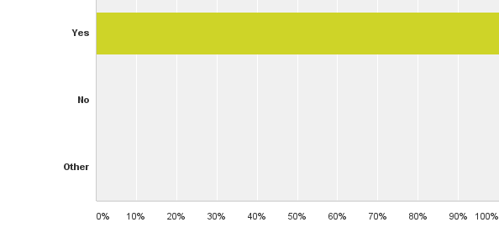
2015 - Have you heard about Pre-Exposure Prophylaxis for HIV?

Slide 45
2014 - Have you heard of the New York State guidelines to prescribe PREP (www.hivguidelines.org)?

Slide 46
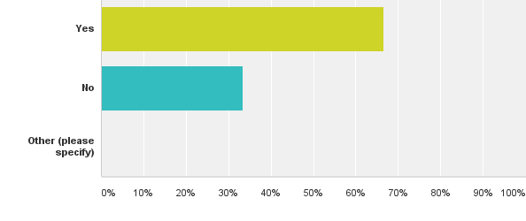
2015- Have you heard of the New York State guidelines to prescribe PREP (www.hivguidelines.org)?

Slide 47
2014- What are the barriers to referring patients to PREP or to prescribing PREP?

Slide 48
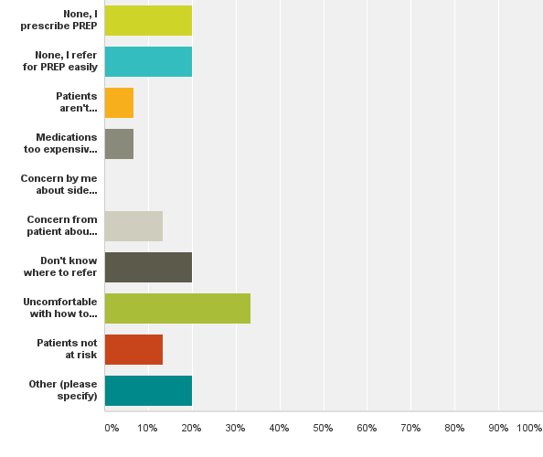
2015-What are the barriers to referring patients to PREP or to prescribing PREP?

Slide 49
2014- Would you rather prescribe these medications yourself or refer to a specialist?

Slide 50
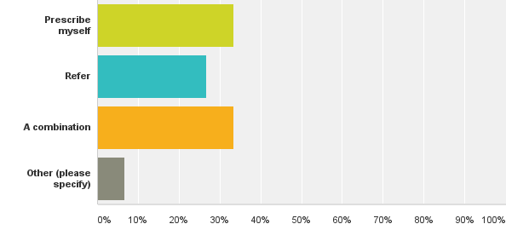
2015 - Would you rather prescribe these medications yourself or refer to a specialist?
“I am not given enough time in my schedule to do this comfortably.”

Slide 51
After a year of PrEP work
Still need to build patient base
Improved knowledge among providers
Improved knowledge of HIV guidelines, where to refer, and improved comfort among prescribing.

Slide 52
Barriers to PrEP | Solutions
Lack of awareness | Work on serodiscordant couples Public Health Messaging Primary Care providers to talk with patients Peer work Community outreach
Don’t know where to get | -Increase knowledge so primary care providers feel more comfortable Link to easy consultation when needed
Not sure can afford | PrEP educator knowledgeable about PA, pharma support
Providers don’t know how to provide | www.hivguidelines.org Support through experienced team
Patients not interested | “If you build it, they will come.”

Slide 53
Resources
www.hivguidelines.org
CEI PEP/PrEP Line: 1-866-637-2342
http://www.nyc.gov/html/doh/html/living/prep-pep.shtml
www.truvada.com

Slide 54
Thank you
To Demetre Daskalakis, MD for the use of his slides.
To our HRHC team – HIV-team and non-HIV team – to motivating our response to PrEP
To you, for being part of the team to bring us closer to the end of AIDS

