Slide 1
Together We Can Prevent HPV-Related Cancers
Kristin Oliver, MD, MHS
Assistant Professor, Pediatrics & Environmental Medicine and Public Health
Icahn School of Medicine at Mount Sinai
Consultant, New York City Department of Health and Mental Hygiene

Slide 2
Disclosures
I have no financial disclosures.

Slide 3
The learner should be able to:
Discuss latest trends in HPV disease prevalence and prevention.
Employ evidence-based techniques for increasing HPV vaccination rates in your own practice.
Apply useful & compelling communication strategies and practical tips to inform parents about HPV.

Slide 4
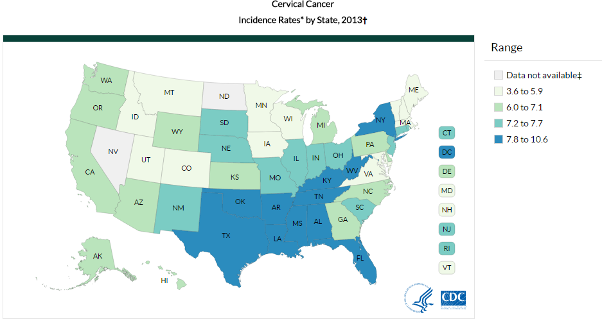
State Variation in Rates of Cervical Cancer
Cervical Cancer Incidence Rates by State, 2013
Over 4,ooo women die from cervical cancer in the US each year
Data Source: www.cdc.gov/cancer/cervical/statistics/state.htm

Slide 5
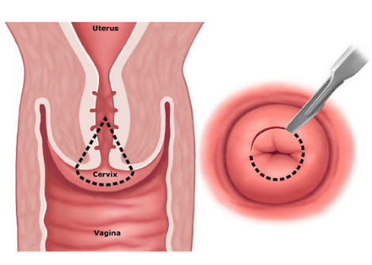
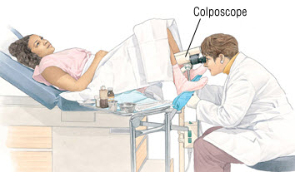
Implications of Pre-Cancerous Lesions

Slide 6
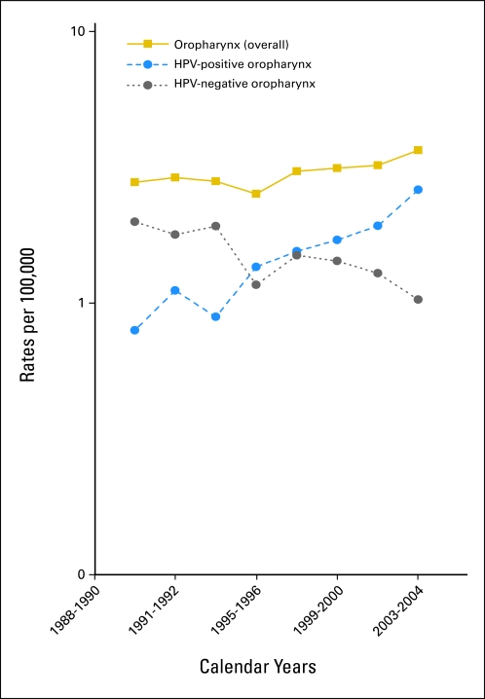
HPV-Related Oropharyngeal Cancer
Has surpassed cervical cancer as the most common HPV related cancer
HPV-related cancers
Increased by 225% in past 20 years

Slide 7
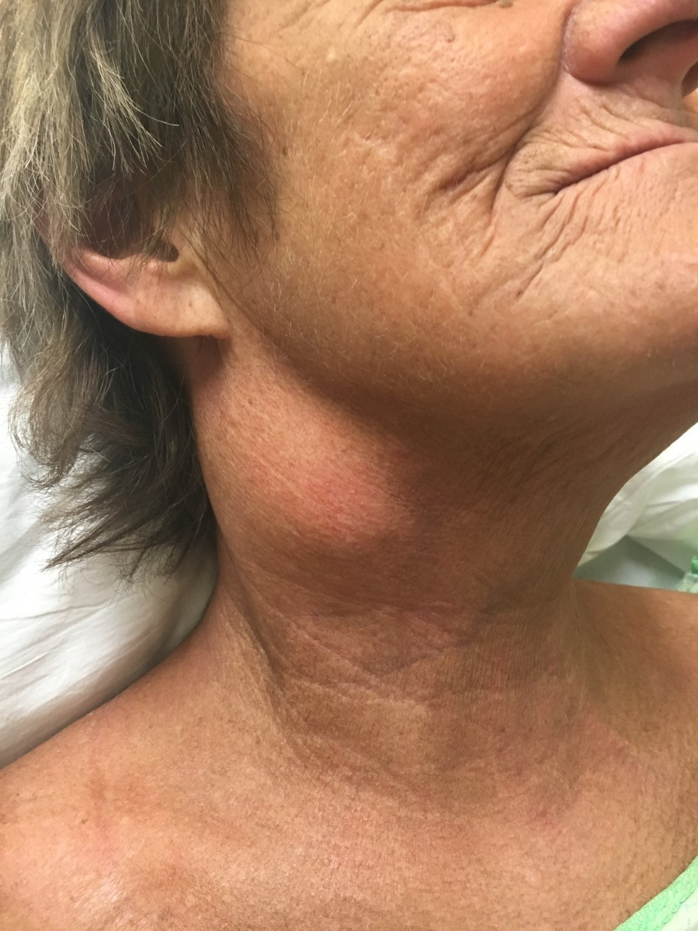
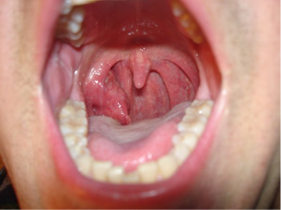
Oropharyngeal Cancers
Photo Credit: Dr. Michael Moore, UC Davis

Slide 8
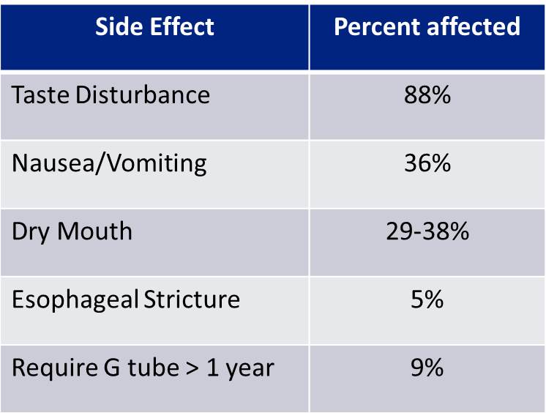
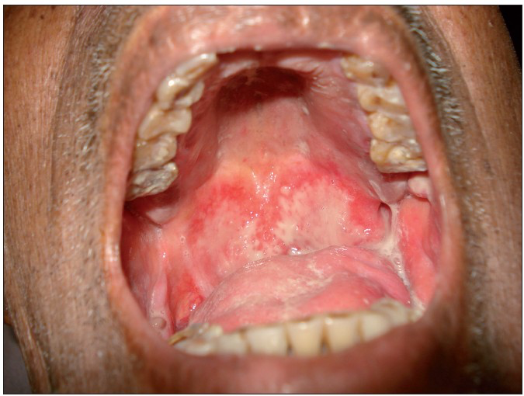
Side Effects of Non-surgical Therapy
Data Source: Irune, et al, 2014; Kocak-Uzel, et al, 2014; Nutting, et al, 2011; McBride, et al, 2014
Photo Credit: http://www.jpalliativecare.com/viewimage.asp?img=IndianJPalliatCare_2010_16_2_74_68408_f3.jpg

Slide 9
Average Number of New Cancers Probably Caused by HPV, by Sex, United States, 2008-2012
Penis n=700 6%
Rectum n=200 2%
Vagina n=600 3%
Vulva n=2,400 13%
Anus n=3,000 16%
Anus n=1,600 14%
Oropharynx n=2,000 10%
Cervix n=10,700 56%
Oropharynx n=9,100 78%
Women (n = 19,200)
Men (n = 11,600)
Data Source: MMWR 2016;65(26):661-666.
Notes:
Survivor story
https://www.youtube.com/watch?v=UskIETAMfXM&feature=youtu.be

Slide 10
Prevalence of Genital Warts per 1000 Person-Years Among Enrollees in Private Health Plans, Males

Slide 11
Incidence of Diseases Covered in Adolescent Vaccine Series
Annual Incidence per 100,000
Meningococcal Data Source: 2014 CDC ABCs
Pertussis Data Source: 2015 CDC ABCs
Cervical & Oropharyngeal Data Source: 2008-2012 SEER

Slide 12
Deaths from Diseases Covered in Adolescent Vaccine Series
Estimated annual deaths
Meningococcal Data Source: 2014 CDC ABCs
Pertussis Data Source: 2015 CDC ABCs
Cervical Data Source: 2016 American Cancer Society

Slide 13
Percentage of HPV types found in common HPV related cancers, US Data

Slide 14
HPV Vaccine Recommendation
Routine Vaccination at 11-12 years
Girls & Boys can start HPV vaccination at age 9
Preteens should finish HPV vaccine series by 13th birthday
Girls 13-26 years old who haven’t started or finished HPV vaccine series
Boys 13-21 years old who haven’t started or finished HPV vaccine series
But better late than never!!!

Slide 15
2018 Immunization Schedule
Recommended
Age at 1st dose of HPV vaccine
Before 15th Bday: 2 doses
On or after 15th Bday: 3 doses
Immunocompromised: 3 doses

Slide 16
One or More Doses HPV Vaccine Among Females and Males 13-17 Years of Age, US
Source: CDC NIS Teen 2016. MMWR Aug 25, 2017

Slide 17
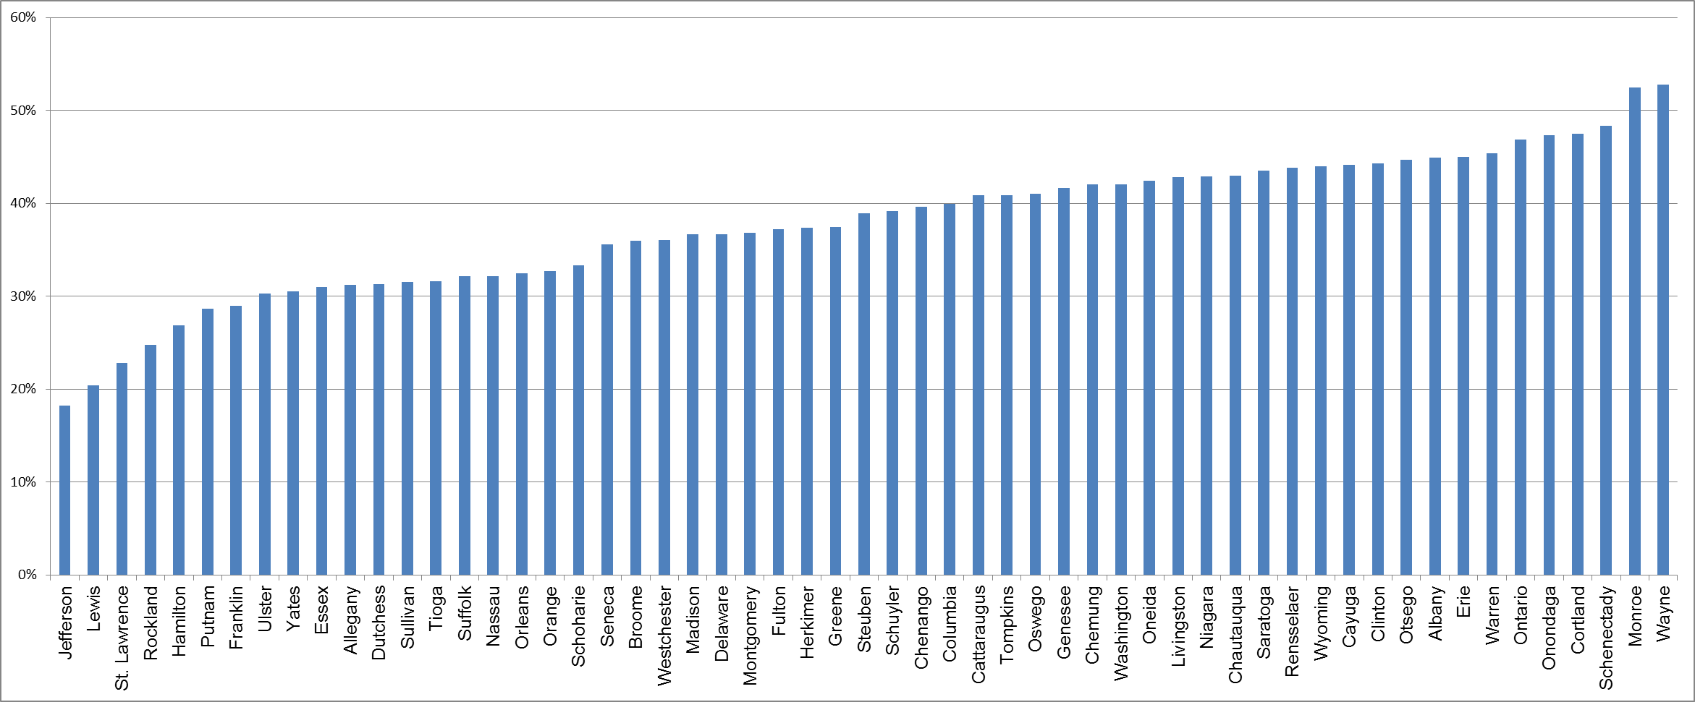
New York State HPV Vaccine 3 doses Girls 13-17 Years, by County, 2015
Data Source: NYSIIS

Slide 18
HPV Vaccine Coverage Among Females and Males 13-17 Years of Age, NYC
Healthy People 2020 Goal
78%
74%
62%
57%
Quarter-Year
Source: NYC DOHMH Citywide Immunization Registry (numerators) and NYC DOHMH Epiquery and 2010 US Census (population estimates).
¹ ACIP has recommended routine HPV vaccination for females ages 9-26 since 2006 and for males ages 11-21 since 2011.
² Series can be completed with 2 or 3 doses depending on series initiation at <15 years of age and interval between dose 1 and dose 2 is >5 months

Slide 19
Disparities in HPV Vaccine Coverage, NYC, Series Complete
Females

Slide 20
Missed Opportunities for HPV Vaccine Administration, NYC
Tdap, MCV4, and first HPV doses administered to 11 year-olds each month from January 2005 – April 2017. Overall Tdap and MCV4 doses are shown. HPV vaccine doses are reported separately for males and females.
Reference: Sull M, et al. Pediatrics, 2014;134(6):e1576-1583

Slide 21
Parents of unvaccinated girls – top reasons for not starting HPV vaccine series
Stokley et al. MMWR. 2014.

Slide 22
Value Parents Place on the Vaccines
Adapted from Healy et al. Vaccine. 2014.

Slide 23
Clinician Estimations
Adapted from Healy et al. Vaccine. 2014.

Slide 24
Clinicians Underestimate the Value Parents Place on HPV Vaccine
Adapted from Healy et al. Vaccine. 2014.

Slide 25
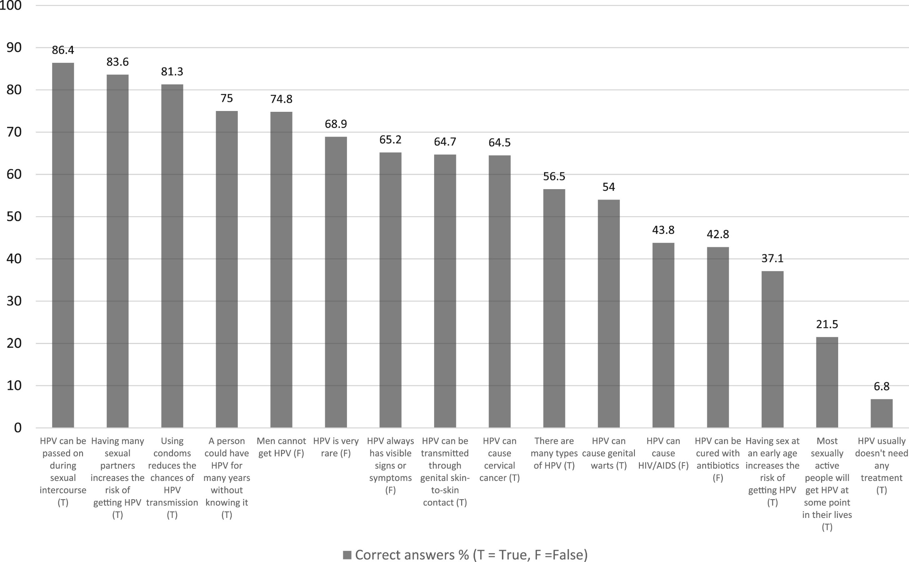
Current Perceptions
Tatar et al. Psychosocial correlates of HPV vaccine acceptability in college males: A cross-sectional exploratory study. Papillomavirus Research 4 (2017).

Slide 26
How Should We Introduce the Vaccine?

Slide 27
Putting “Announcement” into Practice: Same Day, Same Way
“Your child needs 3 vaccines today- Tdap, HPV and meningococcal”
“Today, your child should have 3 vaccines. They’re designed to protect him from meningitis, cancers caused by HPV and tetanus, diphtheria, and pertussis.”
Notes:
Announcement:
http://www.unity4teenvax.org/home/unity-projects/
Video 2: from 2:45 to 3:40

Slide 28
HPV Vaccine: Same Way, Same Day App
Brief, interactive role-play simulation
Designed to enhance healthcare professionals’ ability to introduce HPV vaccine and address hesitant parents’ concerns
Developed by Academic Pediatric Association, American Academy of Pediatrics, and Kognito
Free
Available for mobile devices:
From the Google Play Store https://play.google.com/store/apps/details?id=com.kognito.hpv_immunization
From the Apple iTunes Store https://itunes.apple.com/us/app/hpv-vaccine-same-way-same-day/id1356847181?mt=8

Slide 29
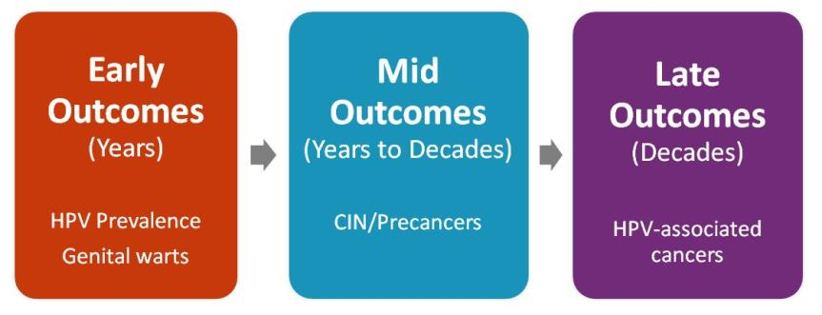
HPV Vaccine Impact
Monitoring Impact of HPV Vaccine Programs on HPV-Associated Outcomes

Slide 30
Vaccine Efficacy from Clinical Trials
Vaccine | Disease | Efficacy, Females | Efficacy, Males
HPV4 | High-grade abnormalities in cervix | 100% | N/A
 | High-grade abnormalities in vagina | 100% | N/A
 | High-grade abnormalities in vulva | 100% | N/A
 | High-grade abnormalities in anus | N/A | 75%*
 | Genital Warts | 99% | 89%
HPV2 | High-grade abnormalities in cervix | 93% | N/A
* Only among men-who-have-sex-with-men

Slide 31
Impact on HPV Vaccine-Type Prevalence: U.S.
Pre-Vaccine Era, Early Vaccine Era and Later Vaccine Era
61% decline
71% decline
This corresponds to vaccine effectiveness of 83%
Oliver, et al. JID 2017 https://academic.oup.com/jid/article/216/5/594/3892427

Slide 32
Near-disappearance of genital warts in Australia following introduction of HPV vaccination
*70% vaccination rate for females only
Percent reporting genital warts
93% reduction in girls <21
82% reduction in boys <21
Ali H et al. BMJ 2013;346:bmj.f2032
©2013 by British Medical Journal Publishing Group

Slide 33
Zero Cases of HPV-Related Cancers in Vaccinated Women
Malignancy | HPV Vaccinated women (65,565 person-years) |  | Non- vaccinated women (124,245 person-years)
 | N | Rate (95% CI) | N | Rate (95% CI)
Cervix | 0 | - | 8 | 6.4 (3.1,13)
Vulva | 0 | - | 1 | 0.8 (0.1, 5.7)
Oropharyngeal | 0 | - | 1 | 0.8 (0.1, 5.7)
All HPV associated cancers | 0 | - | 10 | 8.0 (4.3, 15)
Luostarinem, T. Vaccination protects against HPV-associated cancers. Int. J. Cancer 2018
https://www.ncbi.nlm.nih.gov/pubmed/29280138

Slide 34
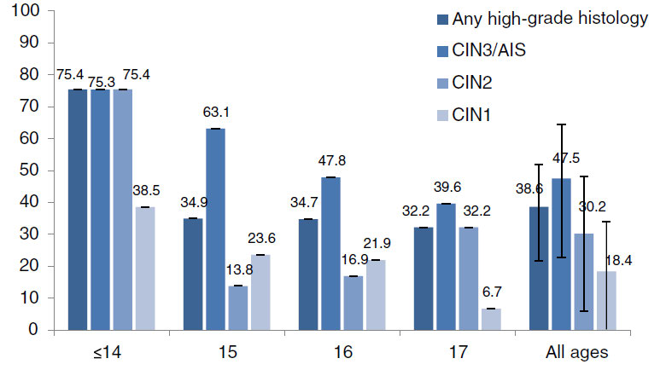
HPV Vaccine Effectiveness
Percent reduction in cervical dysplasia 5 years after vaccination, by age in 2007
Percent dysplasia reduction
Age at introduction of vaccination
Graph Source: Gertig DM, 2013

Slide 35
Does Immunity Last?
Follow-up through month 60
RESULTS: Antibody kinetics
Similar in 2 groups
Steady
> Natural infection
2 doses (0, 6 mos) (ages 9-14 y)
3 doses (0, 1, 6 mos) (ages 15-25 y)
Natural infection
Data Source: Adopted from Romanowski, 2016

Slide 36
HPV Vaccine Safety

Slide 37
United States Vaccine Safety System
System | Collaborators | Description
Vaccine Adverse Event Reporting System (VAERS) | CDC and FDA | Frontline, spontaneous reporting system to detect potential vaccine safety issues
Vaccine Safety Datalink (VSD) | CDC and 8 integrated health care systems | Large-linked database system used for active surveillance and research ~9.4 million members (~3% of US pop)
Clinical Immunization Safety Assessment (CISA) Project | CDC and 7 academic centers | Expert collaboration that conducts individual clinical vaccine safety assessments and clinical research
Post-Licensure Rapid Immunization Safety Monitoring Program (PRISM) | FDA and 6 partner organizations | Large distributed database system used for active surveillance and research ~170 million individuals (~53 of US pop)

Slide 38
Over 10 Years of HPV Vaccine Safety Data
HPV vaccines are safe
Reactions after vaccination may include:
Injection site reactions: pain, redness, and/or swelling in the arm where the shot was given
Systemic: fever, headaches
HPV vaccines should not be given to anyone who has had a previous allergic reaction to the HPV vaccine or who has an allergy to yeast
Brief fainting spells (syncope) and related symptoms (such as jerking movements) can happen soon after any injection, including HPV vaccine
Patients should be seated (or lying down) during vaccination and remain in that position for 15 minutes
Gee, et al. Hum Vaccine Immunother. 2016.

Slide 39
HPV Vaccine Long-Term Safety Data No increased risk of:
2011- Allergic reactions, anaphylaxis, GBS, stroke, blood clots, appendicitis, or seizures (than unvaccinated or who received other vaccines)
2013 –Blood clots or AEs related to the immune & CNS (almost 1 million girls)
2014 – Venous thromboembolism or blood clots (>1 million women)
2012 & 2014 – Autoimmune disorders (2 studies)
2015 – Multiple sclerosis or other demyelinating diseases
2016- Over 60 other conditions

Slide 40
Case example: The Hesitant Parent
An 19-year old male comes to your office for working papers, You review the immunization registry and note he has never received the HPV vaccine or the second dose of MenACWY.
You offer a ‘presumptive’ recommendation for the vaccines, saying “I see here you haven’t had the second dose of the meningitis vaccine and first dose of the HPV vaccine. We can give those at the end of today’s visit”
Source: Adapted from S. O’Leary AAP 2017 HPV Vaccine Update.
40

Slide 41
Step 1 – Ask the Parent to Share Concerns
Example:
“So you seem to have concerns about the HPV vaccine. Well, that’s perfectly understandable – I’ve had a number of questions about this one. Would you mind sharing what your particular concerns are?” (Note: non-threatening)
“Well, I’ve heard there are some really weird side effects of the HPV vaccine.”
Source: Adapted from S. O’Leary AAP 2017 HPV Vaccine Update.

Slide 42
Step 2 – Reflect, Summarize, Ask, Advise
The provider reflects back what the parent is saying to be sure he/she understands (empathy) and summarizes what has been heard before proceeding, again with permission, to make a recommendation.
Example:
“So I can hear that you’re concerned about vaccine safety. Well, I completely get that – I am too - so I pay really close attention to vaccine safety studies and CDC guidelines. Is it okay if I go over how I’ve come to think about this vaccine?”
Source: Adapted from S. O’Leary AAP 2017 HPV Vaccine Update.

Slide 43
Step 3 – The Crucial Step
Example:
What NOT to say: “Oh that’s crazy, you can’t believe everything you see online .”
What TO say: “I used to think of this vaccine as something to prevent a sexually transmitted disease, but realized it’s really about preventing cancer. Almost everyone gets this virus, so I think it’s important for everyone.”
Source: Adapted from S. O’Leary AAP 2017 HPV Vaccine Update.

Slide 44
Step 3 – The Crucial Step
Example:
What TO say: “The most common side effects are pain, redness and/or swelling. Over 29 million doses of Gardasil 9 have been distributed world wide and it has been carefully studied and shown to be safe. And we also now know that it prevents cancer. Almost everyone gets this virus, so I think it’s really important to get vaccinated today.”
Source: Adapted fron S. O’Leary AAP 2017 HPV Vaccine Update.

Slide 45
Summary: How to Handle Resistance
Engage the patient respectfully and fully in the discussion
Use empathy, collaboration, evocation and support for autonomy
Use open-ended questions and reflections
Use of behavior change principles like emphasizing social norms, pivoting from debunking the myth that she is too young, and focusing on the disease that is prevented rather than negatives (like side effects)
Make a clear, strong, and personalized recommendation
Notes:
If needed can do UNITY video here
http://www.unity4teenvax.org/home/unity-projects/
Video 2
MD answers safety questions: 5:01 to 6:27
MD does motivational interviewing with parent w questions: 11:41 to 15:55
MD does MI with parent who refuses: 17:30 to 23:17
NOTE ALL these were pre 2 does recommendation – so today Taylor (who looks less than 15 would only need 2 doses!)

Slide 46
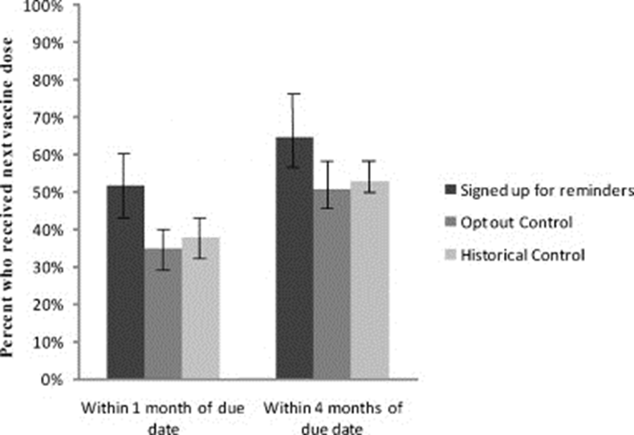
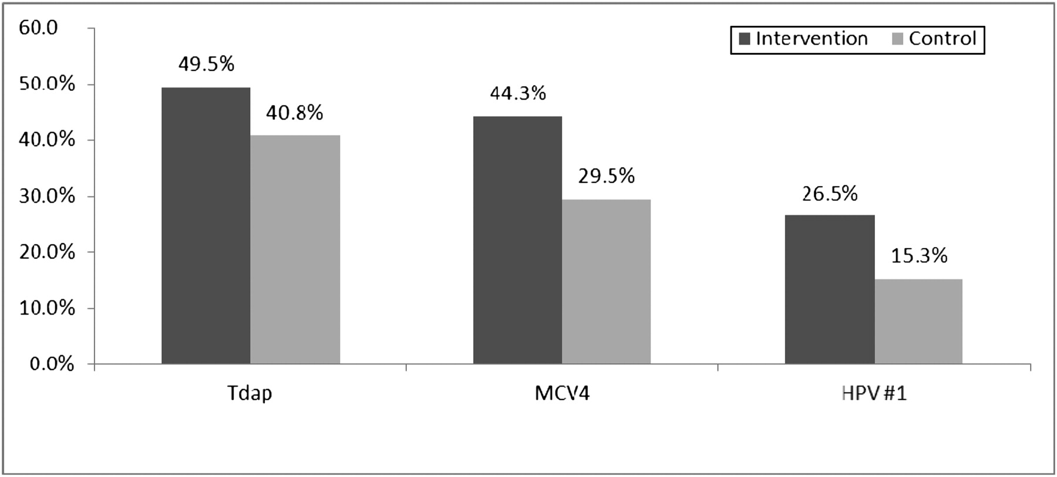
Reminder/Recall Strategies Can Increase HPV Vaccination Rates
Text Messages¹
Letters & Telephone calls²
HPV
Graph Sources: Left) Kharbanda. E et al., 2011; Right) Suh CA et al., 2012

Slide 47
Standing Orders
Single physician order for all patients for recommended vaccines
Stipulate that all patients meeting certain criteria should be vaccinated – age, underlying medical condition
Components
Nurse/MA tracks immunization history
Nurse/MA identifies eligible patients
Nurse/MA educates patients –alert provider if patient still has questions or wants to talk with the provider
Nurse administers vaccines

Slide 48
Benefits of Standing Orders
Shown to be effective in both adults and children
For children, use of standing orders is associated with a median increase in vaccination coverage of 28%
Most effective evidence-based method
Overcome administrative barriers and save time
‘Presumptive’ recommendation in action
Source: www.thecommunityguide.org/vaccines/RRstandingorders.html

Slide 49
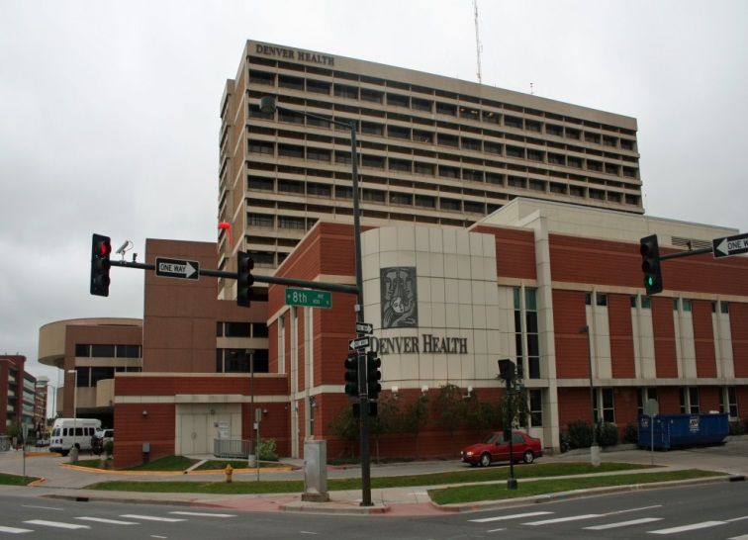
The Denver Health Story
Large vertically integrated community health system
Cares for about 1/3 of all children in Denver
8 community health centers, 16 school-based health centers
For many years, had ‘typical’ immunization process, with similar rates to national average
Photo Credit: https://commons.wikimedia.org/wiki/File:The_Childrens_Hospital_of_Denver_Front.JPG

Slide 50
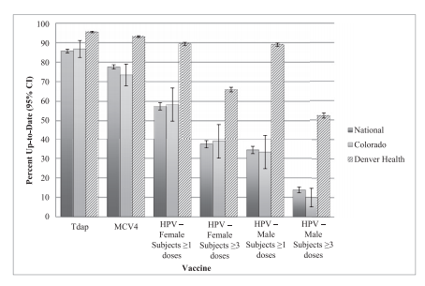
Adolescent Vaccine Rates with Standing Orders
Graph Source: Farmar, Anna-Lisa M., et al., 2016

Slide 51
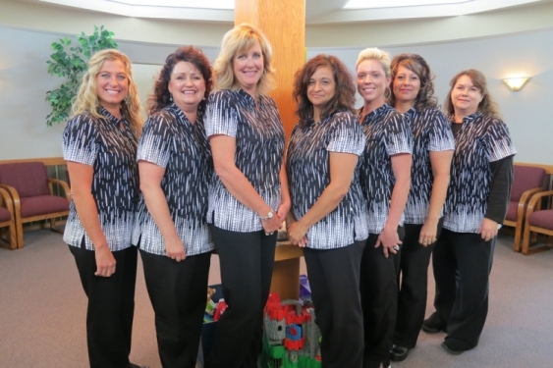
Office Staff

Slide 52
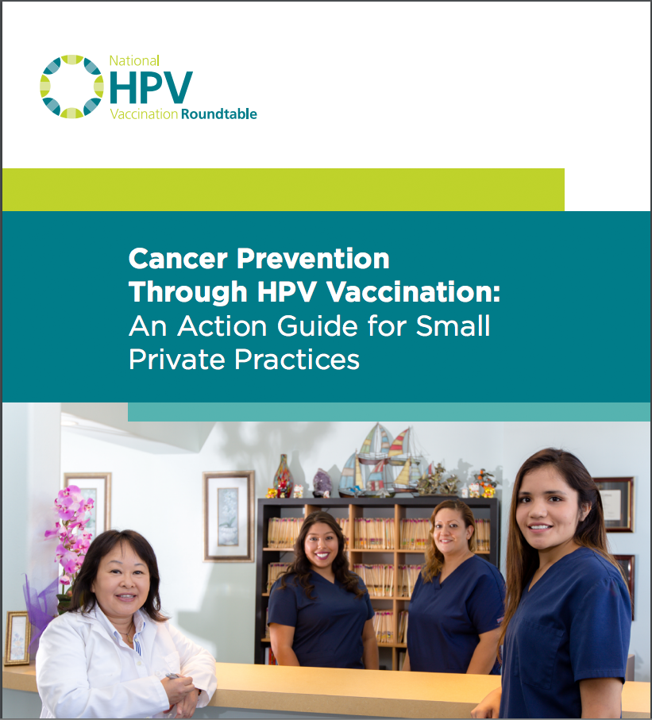
Resources for Office Staff

Slide 53
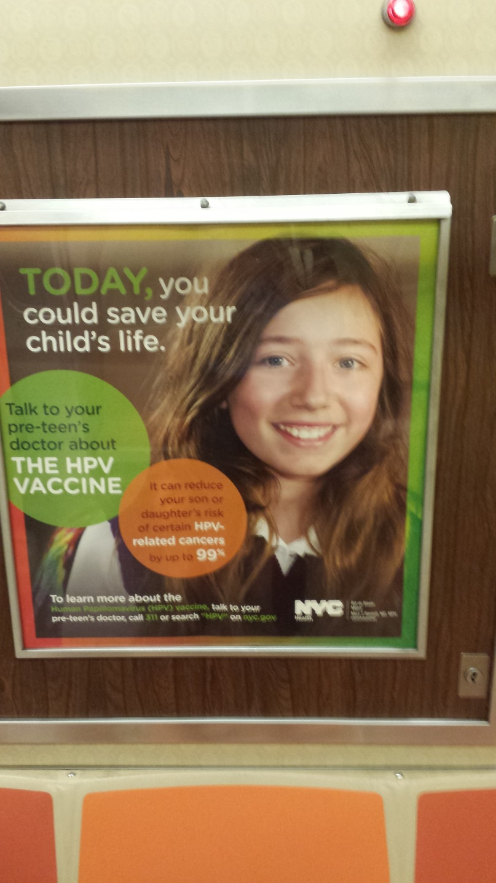
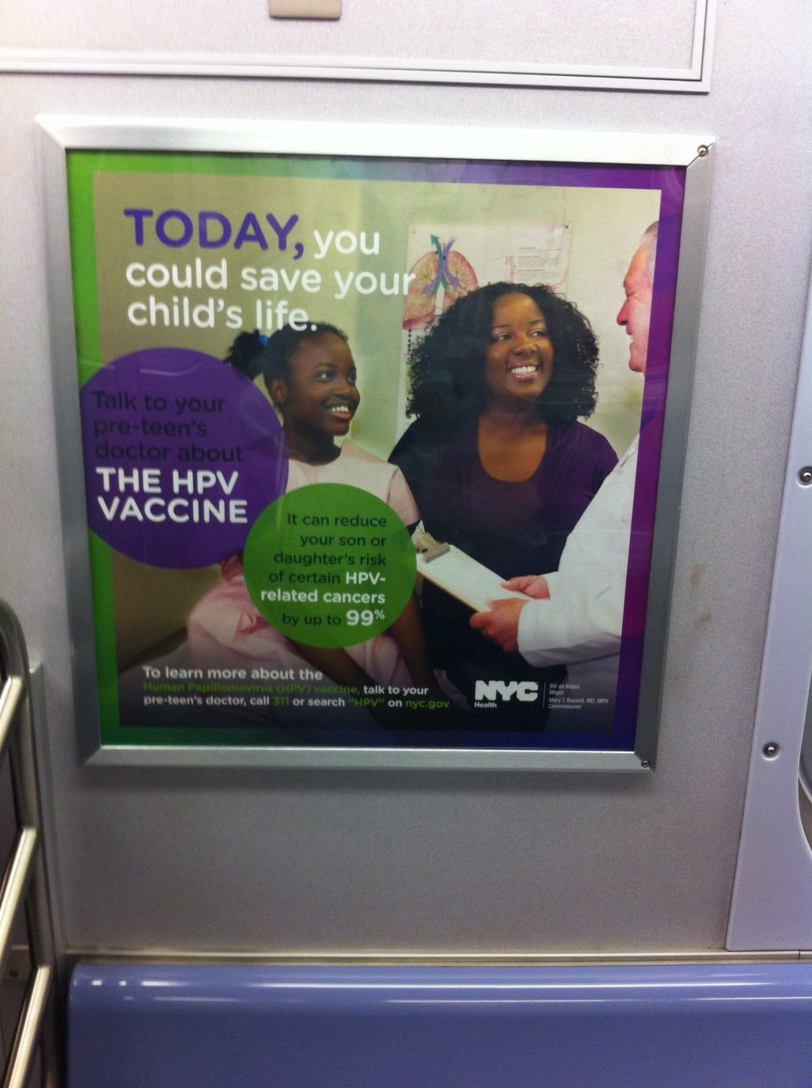
NYC Advertising Campaign

Slide 54
Effectiveness Evaluation of Citywide HPV Campaigns, 2014

Slide 55
HPV VACCINATION RESOURCES

Slide 56
For More Information
CDC
https://www.cdc.gov/hpv/hcp/index.html
AAP
https://www.aap.org/en-us/advocacy-and-policy/aap-health-initiatives/immunizations/HPV-Champion-Toolkit/Pages/HPV-Champion-Toolkit.aspx
National HPV Vaccination Roundtable: Action Guides
http://hpvroundtable.org/action-guides/

