Slide 1
Improving Patient Outcomes through Data
CHCANYS CPCI User Training
November 16, 2016
Azara Proprietary & Confidential

Slide 2
Agenda
Why are We Here? Quality Improvement in the Environment of Health Reform
Using CPCI - The Basics
Pre-Visit Planning
Registries
Dashboards
Reports & Scorecards
Measure Analyzer
Steps to Success
Questions

Slide 3
Your Data Can Put You in the Driver’s Seat
Reimbursement Reform is coming (here), knowing your patient population and having confidence in the quality of care provided (the data) is one of the most important pieces of information you can have for negotiation of payer contracts and proving superior care delivery.
Notes:
factors

Slide 4
Or on the Menu…
So how do we prepare ourselves to be successful in this new era?

Slide 5
CHC Success in a Shifting Environment
Affordable Care Act and ACOs (accountable care organizations) create alignment between various stakeholders in the healthcare delivery system to create cost savings
Quadruple Aim
Creating a plan for sustainability
Sustainability
Enhancing Patient Experience
Improving Population Health
Reducing Costs
Improving Staff Work Life
Reimbursement Reform
A shift from Volume to Value

Slide 6
Strategic Initiatives and Measure Alignment
Diabetes
A1c
BP Control
Hypertension
BP Control
Obesity
Child/Adolescent Weight Screening, Activity & Nutrition Advice
Adult Weight Screening
& Follow up
Cancer Screening
Cervical, Breast, Colon
HEDIS
&
PCMH
Meaningful
Use
Sweet Spot
ACO Measures
UDS Clinical
Measures

Slide 7
Bridging the Quality Chasm
Performance Data Reflects Quality of Care Delivered, Financial Reward Achieved
CARE
Document to reflect quality
of care
SYSTEMS
RESULTS
Set up and maintain systems
IT ,EHR Experts, & Quality
Operations & Clinical Staff
Leadership
Maximize credit and $ for work done
Standardize key workflows
Follow key standards and offer feedback
Better Quality & Experience, Lower Cost
Engage staff in continuous quality improvement
Data at Point of Care for coordination and QI
Accurate Data for Reporting
Notes:
Heather

Slide 8
CPCI – Connecting You to Success
CPCI is a reporting and analytics tool that houses data from multiple CHCANYS site’s
Captures structured EHR data and can integrate with other data sources
Provides drill-down capability
Network CHC Site Provider Patient
Provides multiple levels of reporting - Aggregate, Population and Point of Care to be used by various users that provide and support the provision of quality, evidence based care

Slide 9
Reporting Hierarchy in CPCI
Performance Management
Population Management
Daily Care Delivery
Visit Planning
Registries
Referrals
Dashboards
Measures
Reports
Patient Detail

Slide 10
Using CPC The Basics

Slide 11
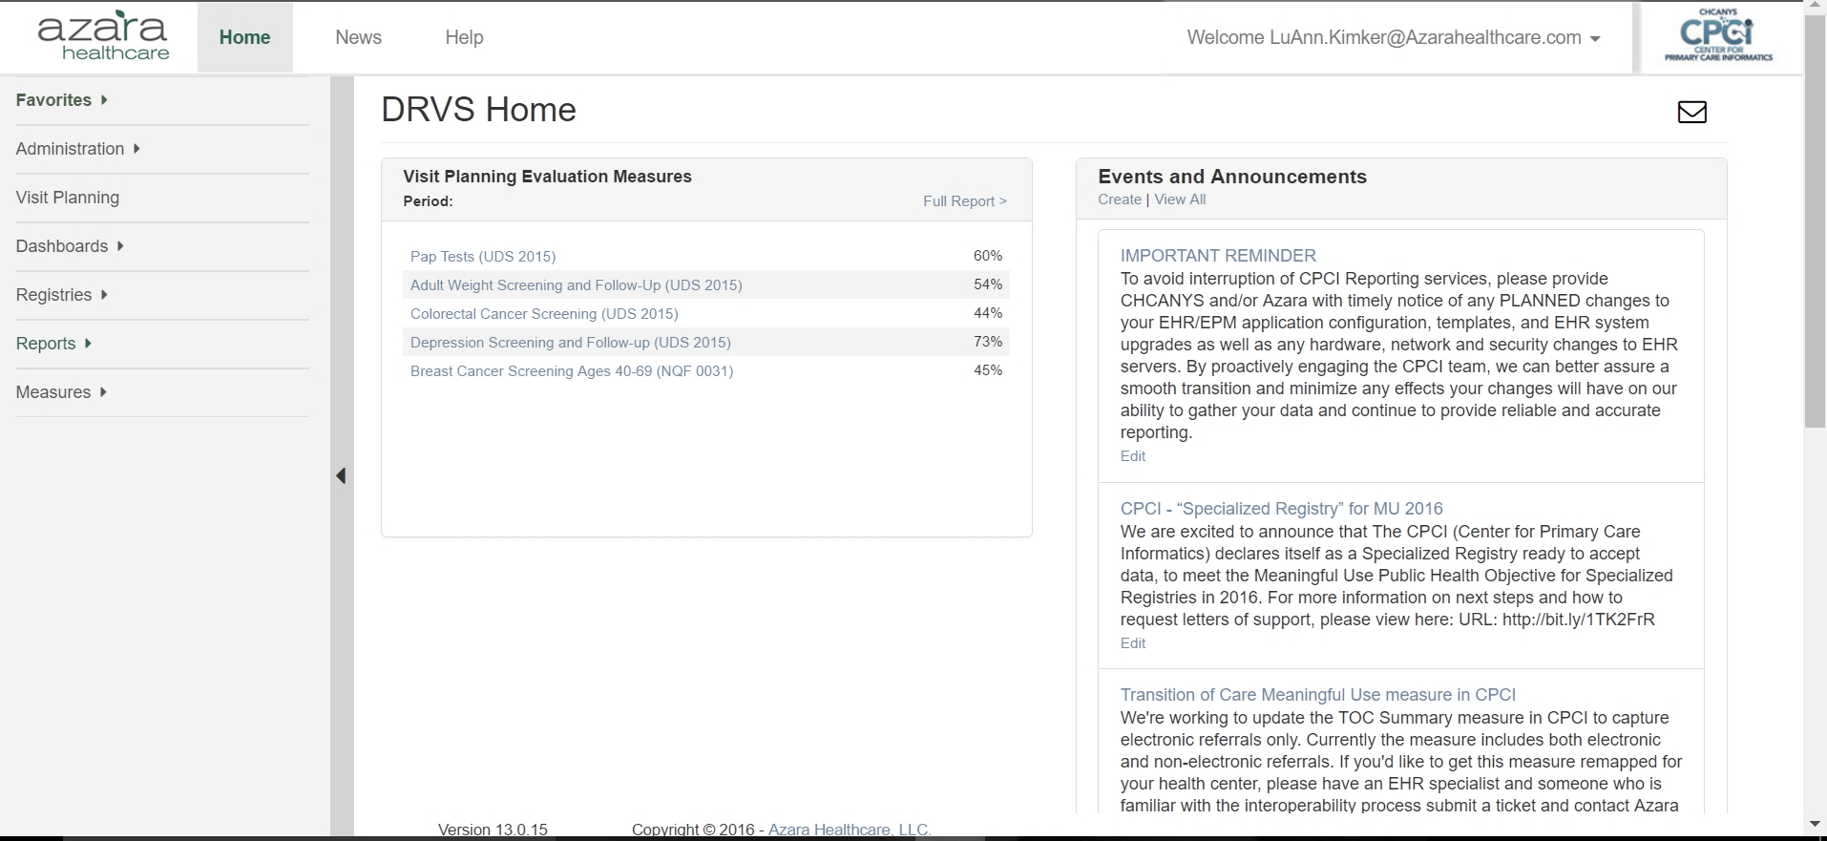
Home Page
User preferences
Top bar Navigation
Main Navigation Bar
Scorecard/Dashboard Panel
Events and Announcements
Email Support
2
1
6
4
5
3

Slide 12
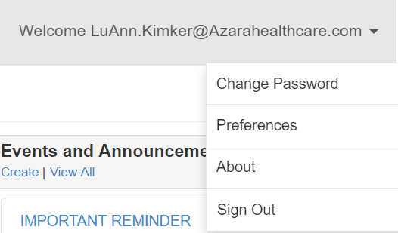
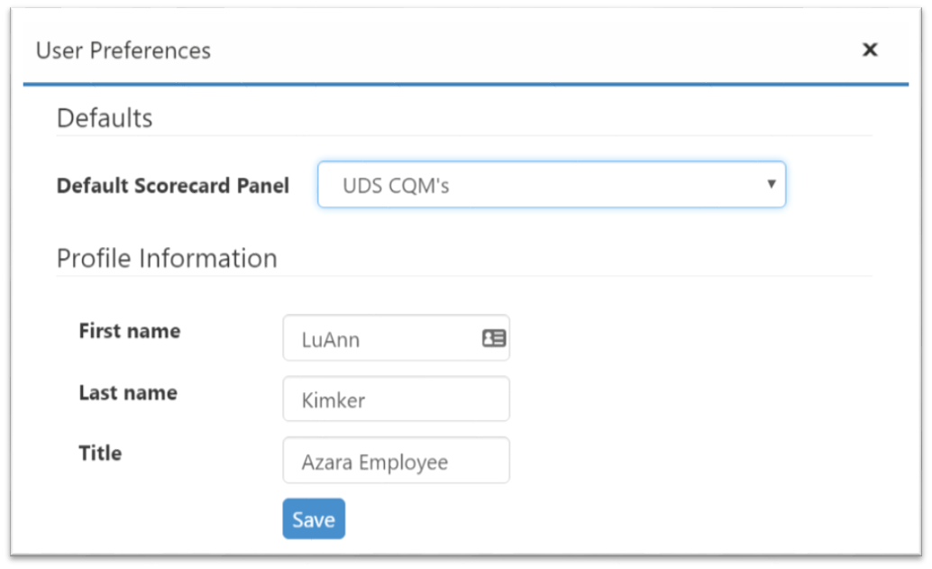
Home Page| User Preferences
Change user preferences
Change password
View ‘about’ information
Log out

Slide 13
Home Page|Help
Resources to assist you with using CPCI
Notes:
FAQ – quick administrative tips e.g., add users, alerts, modify privileges

Slide 14
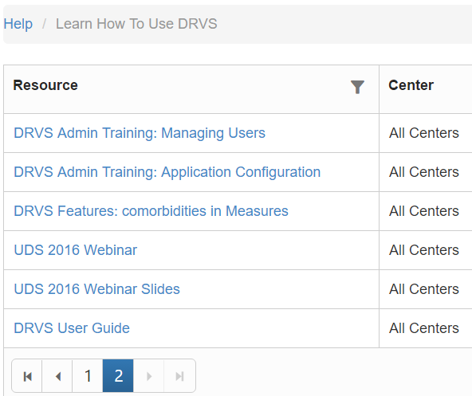
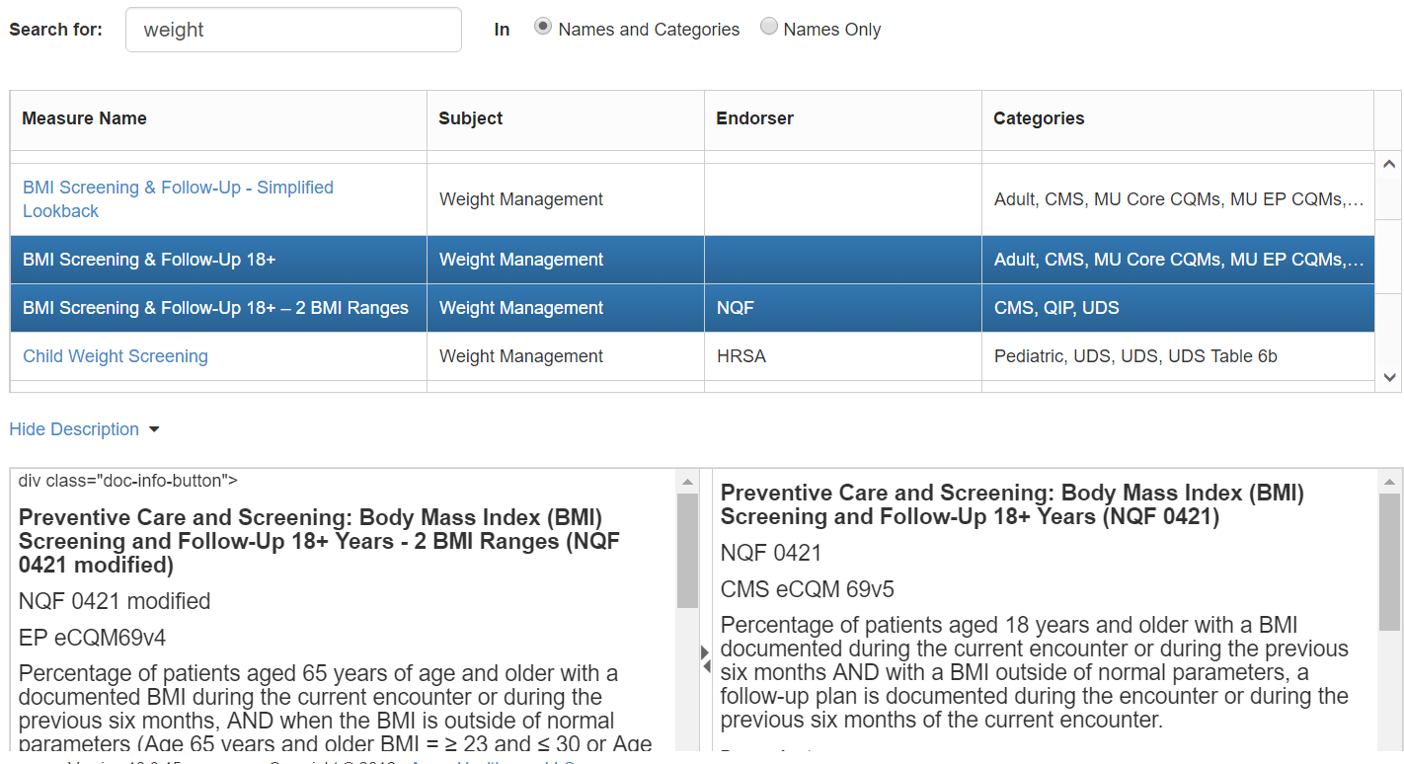
Help
Identify where key data points are mapped from in your EHR

Slide 15
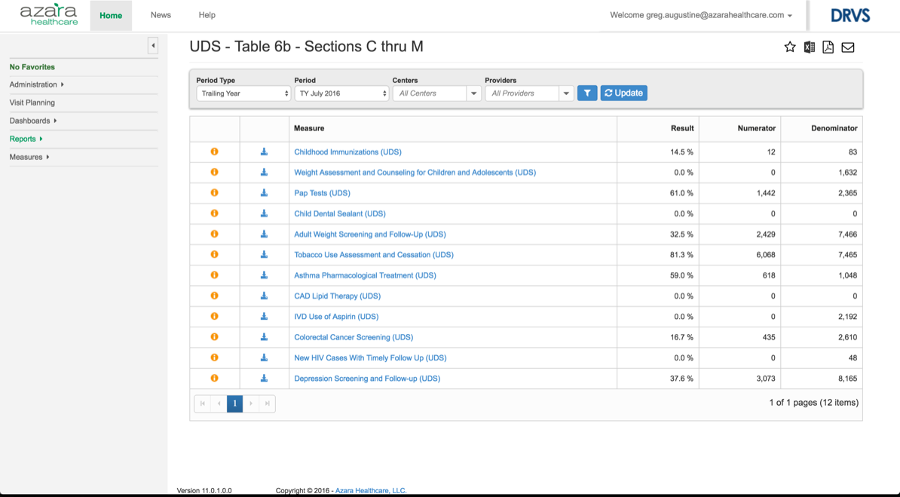
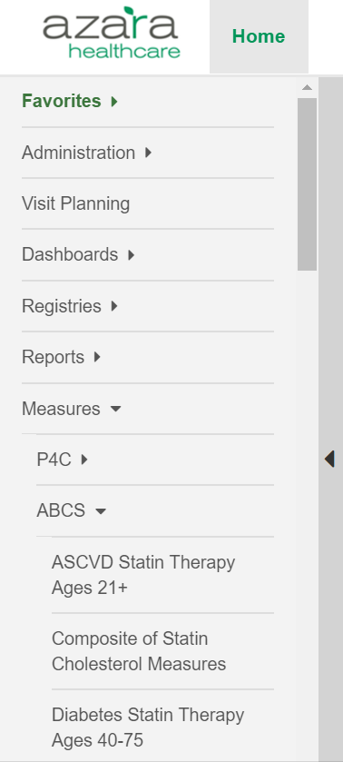
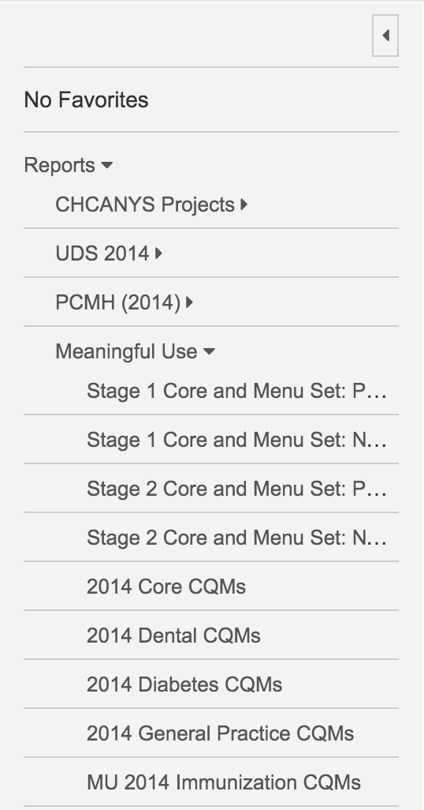
Navigation
Quickly find and run reports / measures and dashboards
Collapsible / Expandable
Favorites – unique to each user
Administration – with administrative privileges

Slide 16
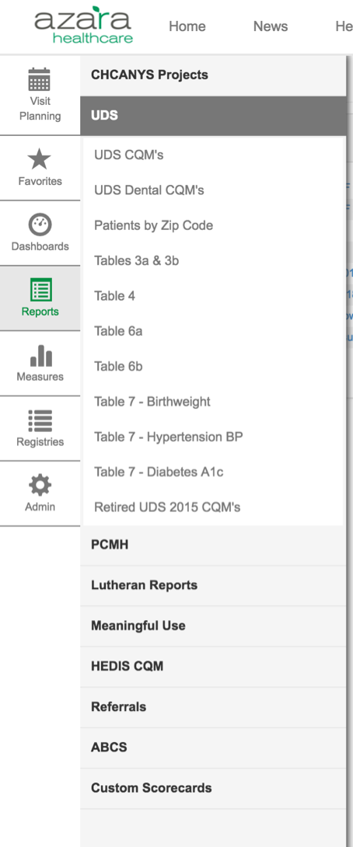
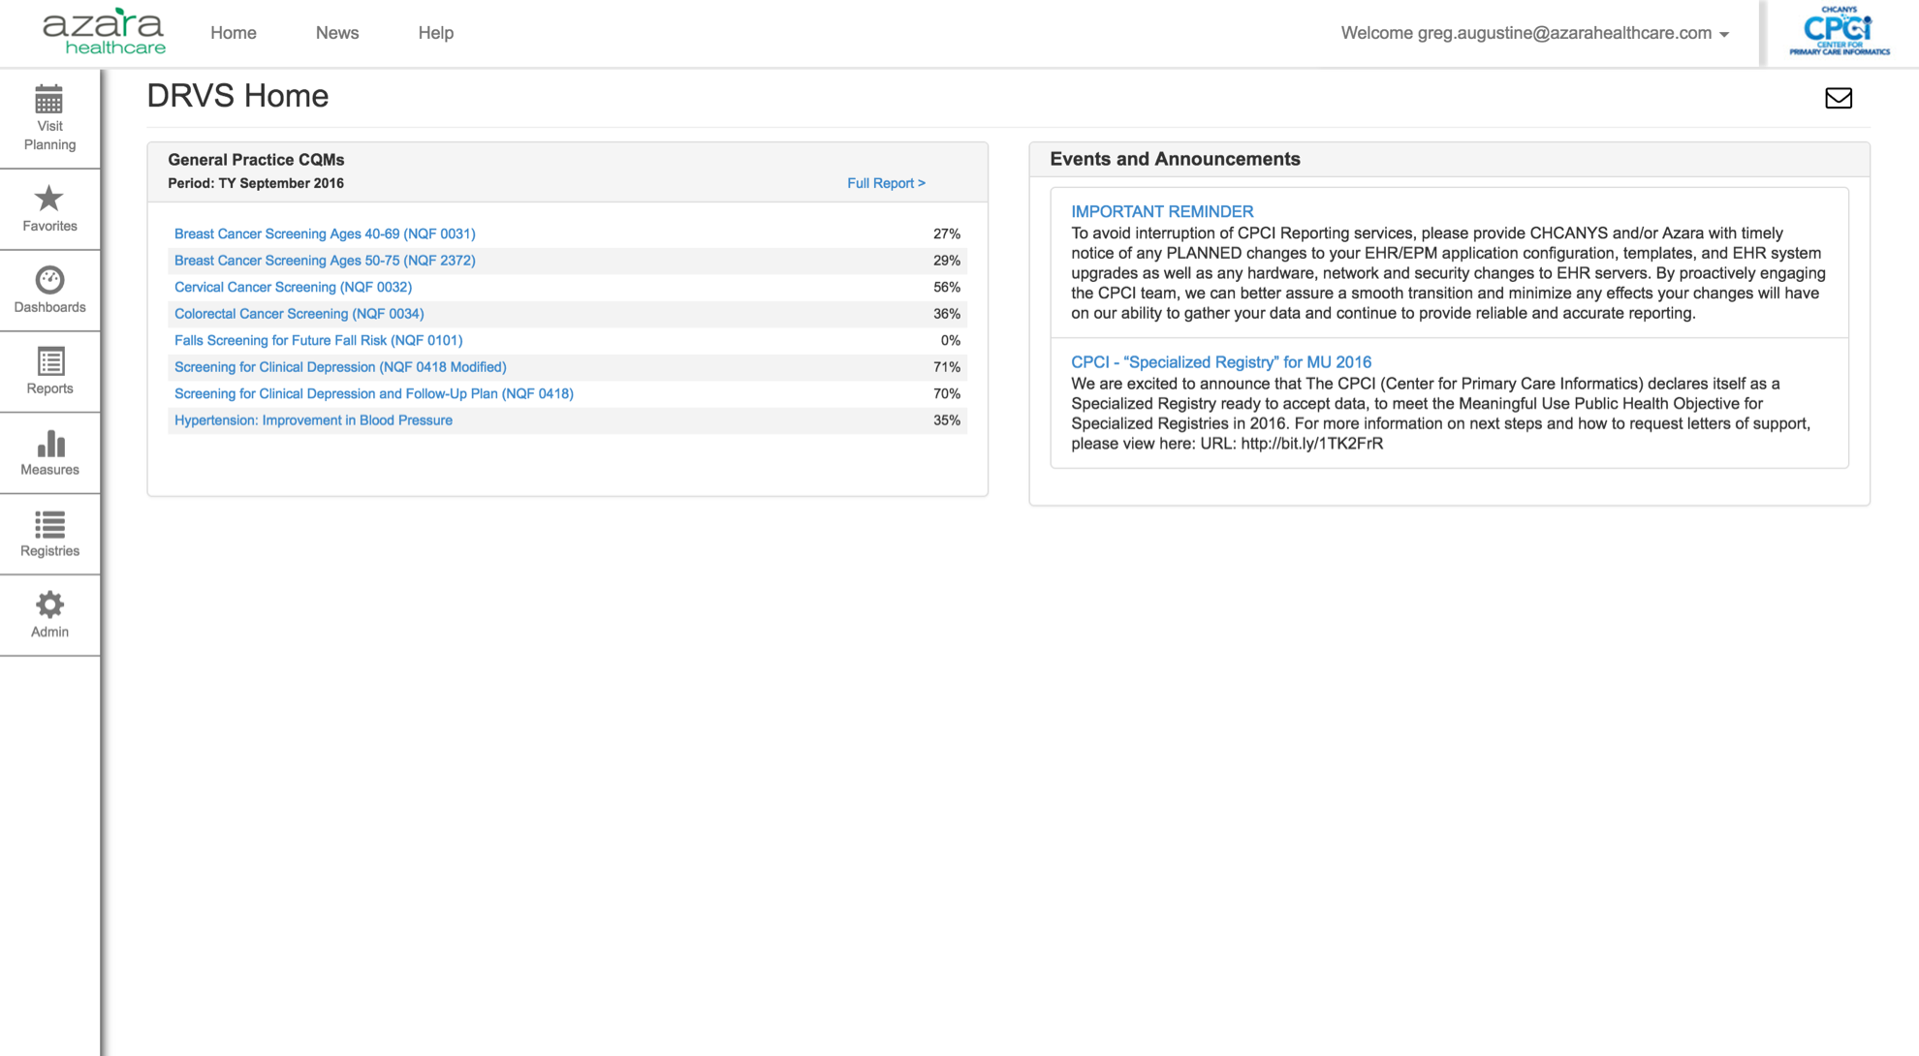
Sneak Peak
User Interface Navigation Changes
Coming in December!

Slide 17
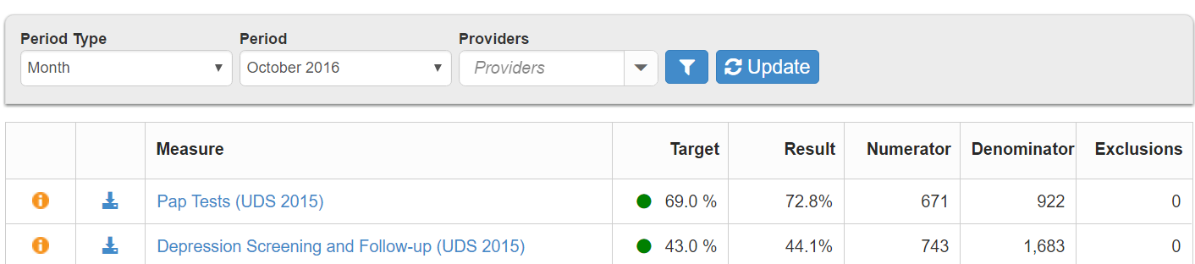
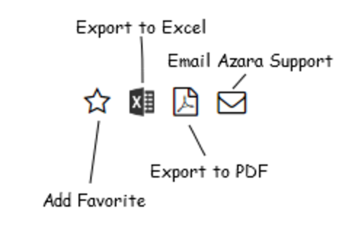
Utility Icons
Located in the right upper corner of reports, measures and dashboards
Common utility actions include
Export to Excel or PDF
Add Favorite
Email Azara Support
Other utility icons include
Information
Add a widget
Line Chart
Show Table
Options
Last Processed date
Edit Dashboard
Column Chart

Slide 18
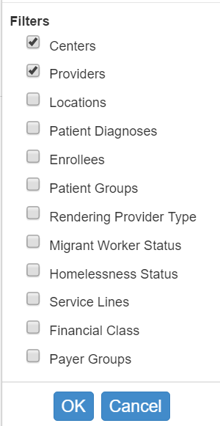
Functionality|Filters
Results can be filtered based on:
Time periods
Provider(s)
Rendering: Delivered care to the patient during an encounter
during the time period selected
Usual: Also referred to as PCP, provider responsible for the care
of the patient (not the PCP listed insurance billing purposes)
Location(s) where service was rendered
Payer Group – custom grouping of health insurance plans
And more….
Use the funnel icon to select desired parameters, filters and groupings
Click and the Update button to save

Slide 19
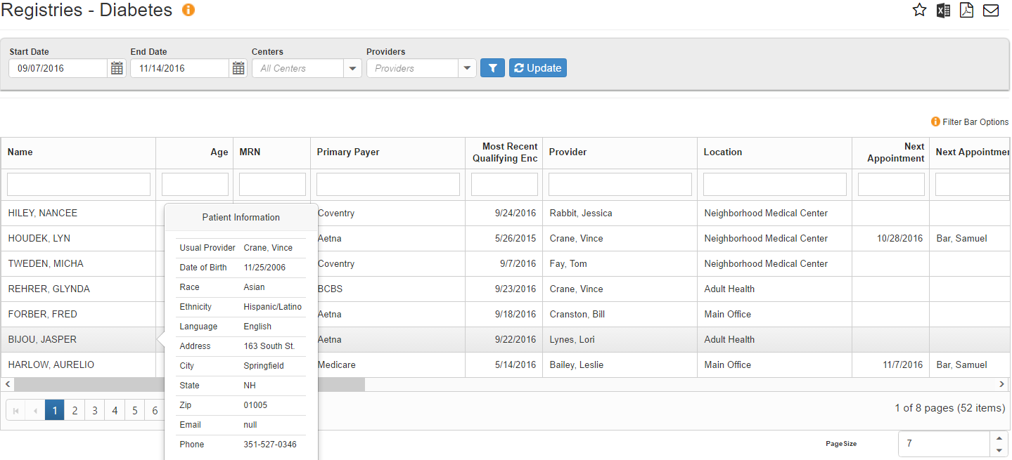
Functionality|Sort, Search, Filter
Detail on all registries and measures can be
Sorted on any column by clicking the column heading
Searched or filtered using the filter box at the top of each column
Roll over patient name for more demographics

Slide 20
Reporting Periods
There are four (4) main “Period Types” to run a Scorecard Report or individual measure in the Measure Analyzer
Year (Calendar)
Trailing Year
Provides a proxy for year-long performance at any point in the calendar year
Quarter
Month

Slide 21
Reporting Period Types
All period types follow and adhere to the same specification with regards to
The length of the measurement period
Patient age / gender criteria
Lookback period for a specific lab, diagnostic image or screening
Azara applies the specifications the same across all period types within DRVS with the following key differences:
Trailing Year
The measurement period start and end dates are shifted and include the trailing 12 months from the month you select e.g., the period for TY September 2014 is 10/1/13 thru 9/30/14
Quarter and Month
The measurement period start and end dates are shifted e.g., the period for Q3 2014 is 7/1/14 thru 9/30/14
The patient must have a visit in the quarter (or month) – between 7/1/14 and 9/30/14

Slide 22
Non-year periods
Specifications, however, are typically written for a calendar year period
For Quarter or Month:
Encounter(s) must have occurred in the period
Lookback period is the same as the year
For example, colonoscopy – the patient must have an encounter in the month (or quarter) but we look back 10 years for the colonoscopy
End periods change depending on period type
A patient’s age is calculated at the end of the period

Slide 23
Non-Year Period Example
Weight Assessment and Counseling for Children and Adolescents
Denominator:
Patients Ages 3-17
Qualifying Encounter in the period
Numerator:
BMI Percentile Recorded in the past 12 months
Nutritional and Physical Activity Counseling in the past 12 months
Encounter
Nutritional Counseling
Encounter
BMI % Out of Range
Encounter
BMI % Out of Range
Encounter
BMI % Out of Range
Patient Turns 18 on March 17th
Feb ‘15
Mar
Apr
May
Jun
Jul
Aug
Sep
Oct
Nov
Dec
Jan ‘16
Feb
Mar
Feb ’15 – Jan ‘16
Feb ’15 – Jan ‘16
Mar ’15 – Feb ‘16
Apr ’15 – Mar ‘16
Apr ’15 – Mar ‘16
Period
Period
Period
Period
Period
Mar ’15 – Feb ‘16
Period
Apr ’15 – Mar ‘16
Period
Apr ’15 – Mar ‘16
Period
Period Type &
Period
Patient Age
Encounter
in Period
BMI Percentile
in Last 12 Mths
Counseling
in Last 12 Mths
Numerator
Denominator
Mth, Jan 2016
Yes
Yes
Mth, Feb 2016
N/A
No
Mth, Mar 2016
N/A
No
Qtr, Q1 2016
N/A
No

Slide 24
Dashboards, Reports and Measures
Dashboards present data as a series of widgets in a graphical format
Three (3) Reports provide needed views for different roles
Patient Visit Planning
Clinical Registry Reports
Patient Level Detail for specific Chronic Conditions (e.g., Diabetes, Hypertension) or Preventive Care Segments (e.g., Adult Female, Adult Male)
Performance Management Reports
Aggregated Data for Meaningful Use, UDS, PCMH, Grant Programs
The Measure Analyzer allows users to complete ad-hoc analysis for specific measures (e.g., A1c > 9)
Review trends
Benchmark providers
Identify outliers and disparities in care

Slide 25
Pre-Visit Planning (PVP)
Building Evidence Based Quality
Into Every Day Practice

Slide 26
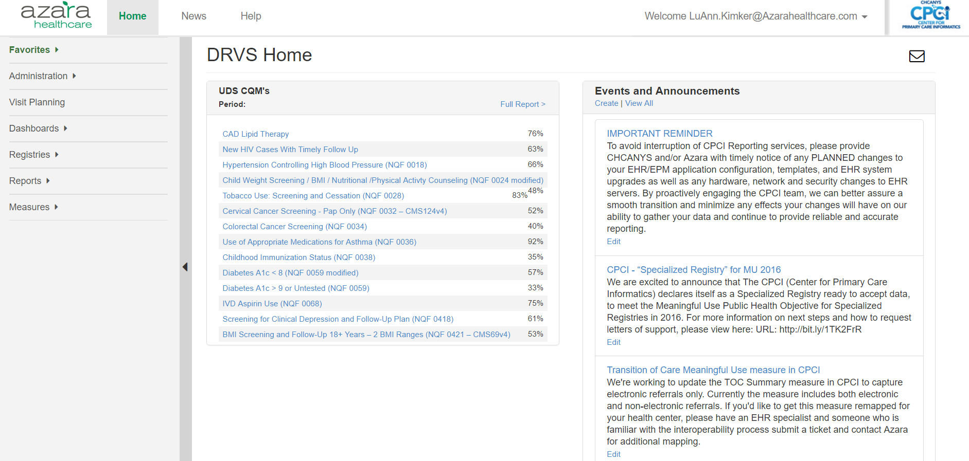
Patient Visit Planning Report

Slide 27
Looking Out for Patient Care
Pre-Visit Planning Report facilitates
more efficient planning for preventive
and chronic care, all in one report
Relevant and actionable items
to help teams prepare for visits
Active diagnoses and relevant risk factors
Visit planning alerts based on evidence based and notational standards
Alerts trigger when clinical parameters, labs or screenings are (a) missing, (b) overdue or (c) out of range
Alerts are configurable for the center, not individual users
An efficient clinical management tool, where success on measures is a by-product of use
Enables care team to anticipate patient needs and plan for their day
FOCUS

Slide 28
Patient Visit Planning
Run the PVP
Prospectively to prepare and plan for patients’ upcoming appointments
Retrospectively to review the success of care teams planning, preparation and execution (based on patients’ most recent encounter)
Reports may be exported and printed as a PDF tear sheet or viewed on desktop
Notes:
Expect the report to take a bit longer to run if running the report for longer periods or your whole center

Slide 29
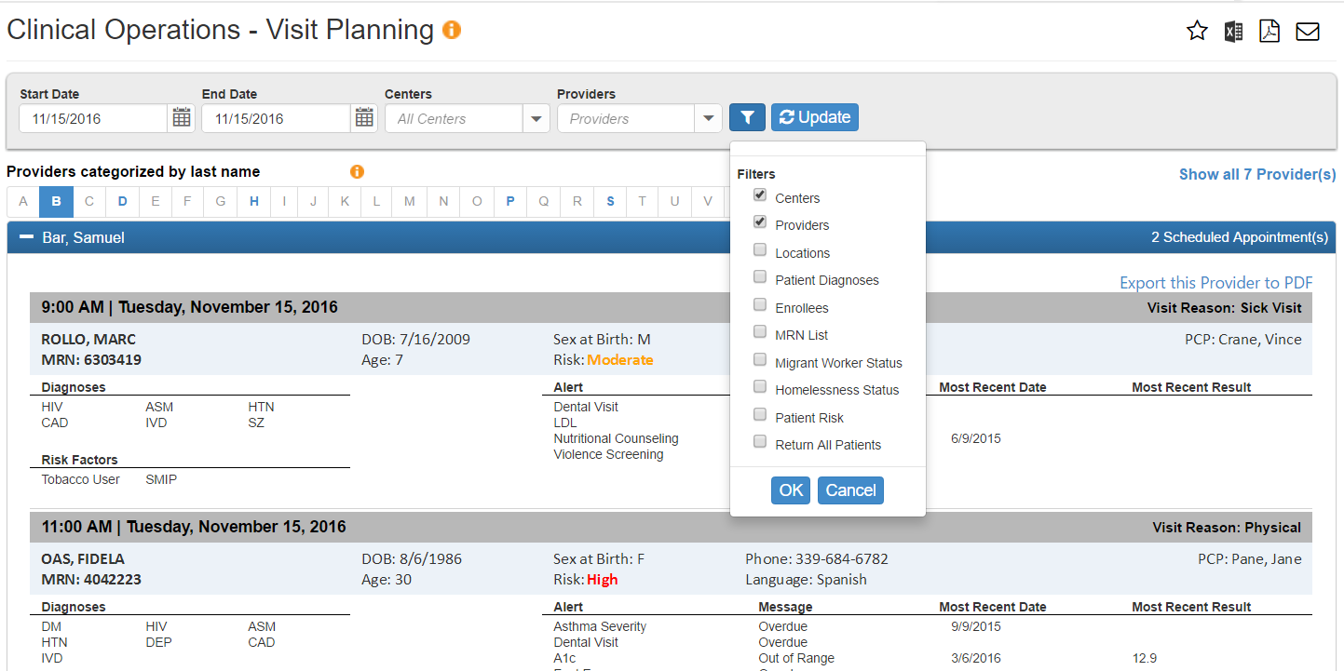
Patient Visit Planning|Details
Change date to pull past, current or future appointments
Add filters to narrow search criteria
Blue letters show providers names starting with that letter who have patients scheduled
Show / hide provider’s schedule
Use MRN to add walk-ins or late add patients under provider ‘W’
View number of providers with a schedule and total number of appointments per provider
1
2
3
6
4
5

Slide 30
Visit Planning|Configuration
Initial settings are stock, you can adjust most alerts for your practice’s needs
Alerts can be turned on / off
Alerts can be associated with specific diagnoses
Look back timeframes can be varied and modified
Min and Max values for labs and blood pressure can be changed
New Alerts will NOT be enabled automatically, they must be enabled by the site
Practices should evaluate the set-up in Administration and decide if adjustments are needed
Changes made will affect the entire practice’s view of the Visit Planning report, they can’t be made for individuals at this time
Enabling and disabling (turning alerts on/off ) occurs immediately in your system, but all other configuration changes will be active in your system the next day

Slide 31
PVP| A Day in Your CHC
Generate the PVP for the next day
Review to identify care gaps
Discuss with the team how you might use the PVP
Are there patients with special needs?
At risk?
Scheduling bottlenecks based on schedule or patient needs
Are there extra services needed?
Is everyone working at the top of their ability?
Do you need to consider new workflows?
Do you see things you’ve done, but they don’t show on the report?

Slide 32
Registries
Additional Investigation of Data and Coordination of Touches with Patients

Slide 33
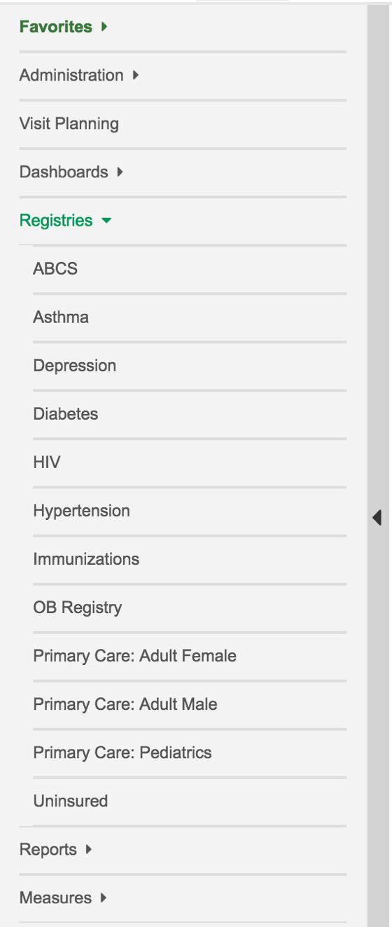
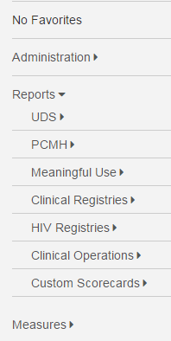
Registry Reports
Current Clinical Registry Reports include:
Adult Female Primary Care
Adult Male Primary Care
Pediatric Primary Care
Immunizations (Childhood)
Diabetes Labs & Services
Asthma Status & Management
Hypertension
HIV
Depression

Slide 34
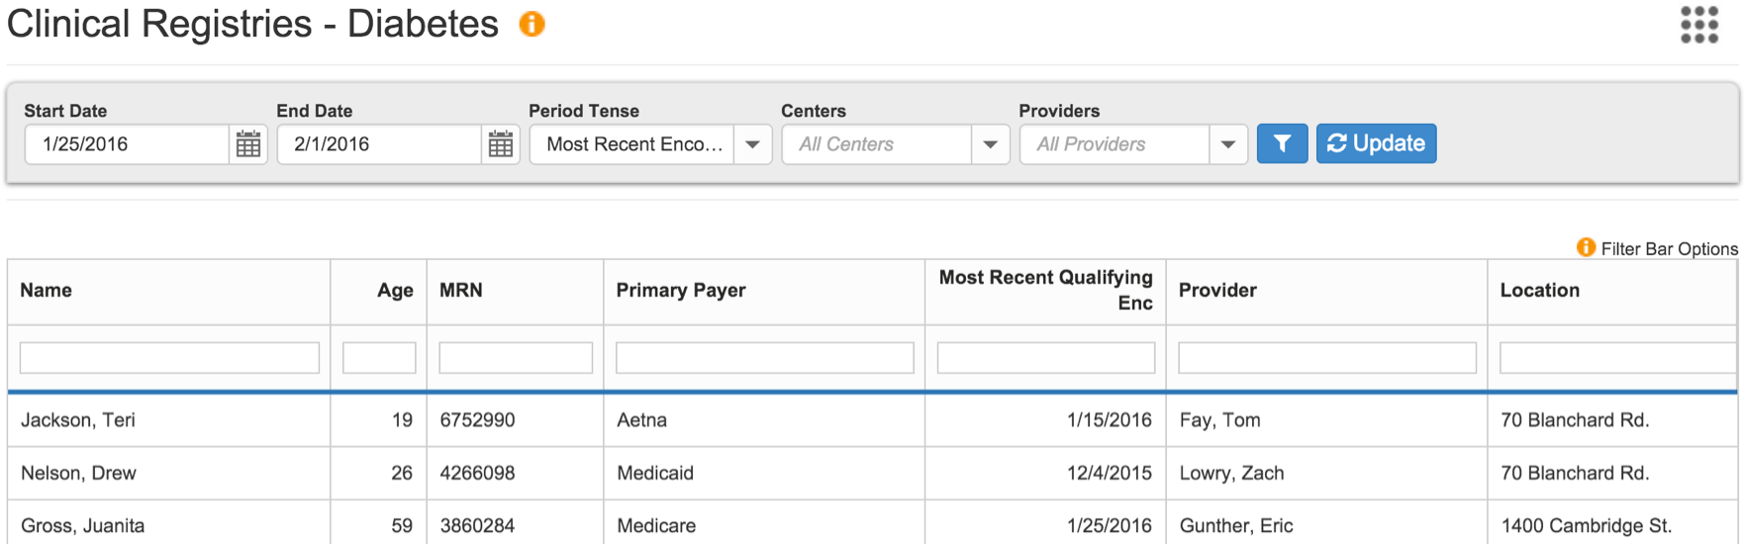
Registry Reports
Population management tool for chronic conditions and preventive care, referral management, as well as data quality
Allow you to create reports with patient level detail that can be used to:
Retrospectively analyze data based on their most recent encounter
Prospectively identify patients who need to be seen or need services at upcoming appointments
A common set of data elements is in each report (e.g., Patient Name, MRN) and a set of data elements specific to the Chronic Disease or Preventive Care category
Notes:
Talk about filtering etc.

Slide 35
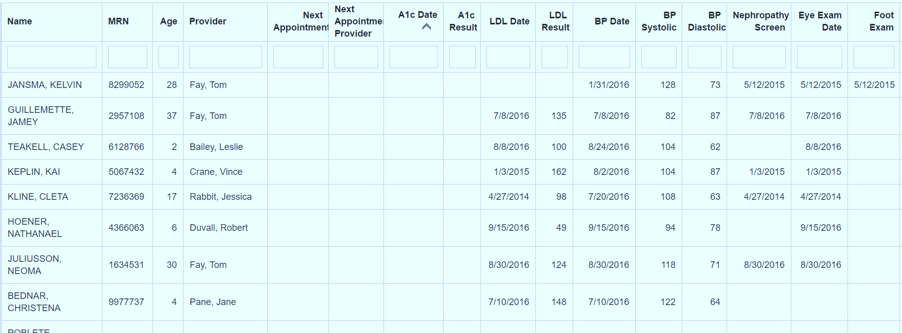
Diabetes Registry|Low Hanging Fruit for QI
Sort by A1c ascending to find patients who have not been tested.
Demo Data

Slide 36
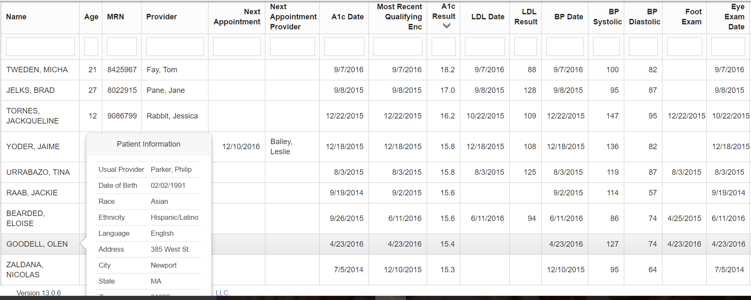
Diabetes Registry - Low Hanging Fruit for QI
Sort by A1c descending to find :
Data quality issues such as Glucose results mis-entered in A1c field
Out of control patients at risk for stroke, hospitalization, etc.
Demo Data
235

Slide 37
Referral Registry/Log
Use the data to understand which stage referrals are get ‘caught’ in to help direct staffing, process, or advocacy changes.

Slide 38
Registry| A Day in Your CHC
Run the Diabetes or Preventive
Care Registry two (2) days after
a patient schedule you were
involved with
Filter by rendering provider
Sort by a few of the data elements in the registry that could have been completed at the time of the visit e.g., A1c, lipids, BMI, depression screen, BP
Did it get done? If not, why?
What would have helped make it happen?
Surprised?

Slide 39
Performance Management|Dashboards
A collection of data points and measures presented graphically to help you understand performance

Slide 40
Dashboards
Default settings represent the performance of your health center as a whole, but can be filtered by provider or location
Targets or goals established for these measures will be displayed, allowing easy assessment and monitoring of performance
Drill down in the ‘widgets’ to access details of the measure in the measure analyzer for further ad-hoc exploration and analysis
Create Custom Dashboards (ala Custom Scorecards) for your CHC by working directly with Azara

Slide 41
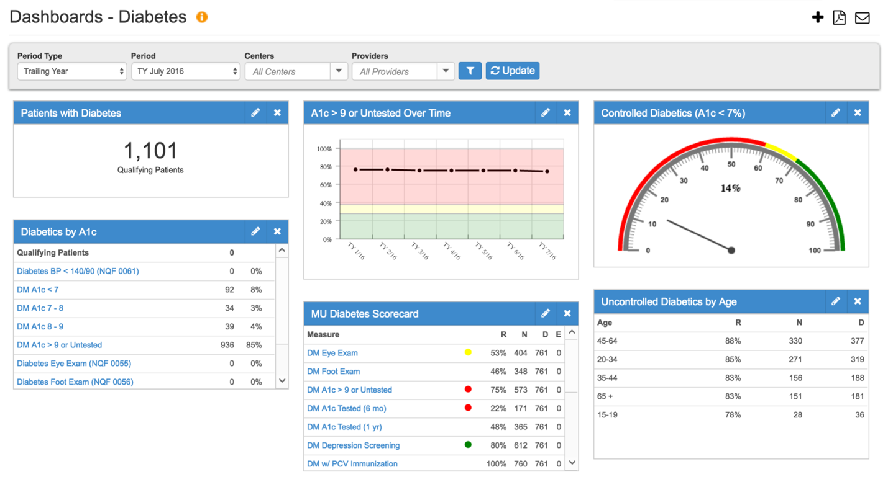
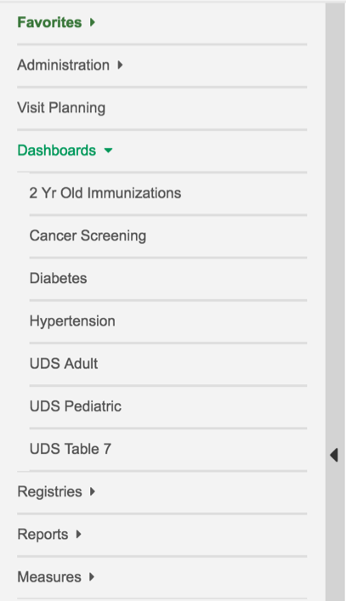
Dashboards
Stock dashboards are available for all sites
Diabetes (see below)
2 Yr Old Immunizations
Cancer Screening
UDS Table 6b - Adult
UDS Table 6b - Pediatric
UDS Table 7
Notes:
Prediabetes/Metabolic Syndrome/Abnormal Glucose

Slide 42
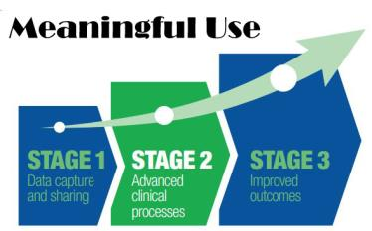
Performance Management|Reports & Scorecards

Slide 43
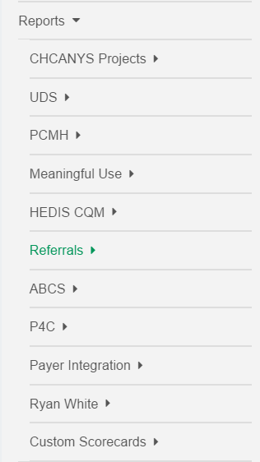
Reports & Scorecards
Groupings of like measures allows analysis of programmatic progress
CDC Cancer Grant
NYS-HCCN Grant
Zip Code Table
Tables 3a & 3b
Table 4
Table 5
Table 6a
Table 6b
Table 7
Adult Diabetes
Adult Preventive
Pediatric Asthma
Pediatric Preventive
Stage 2 Objectives
Core CQMs
Dental CQMs
Diabetes CQMs
General Practice CQMs
HIV CQMs
Heart CQMs

Slide 44
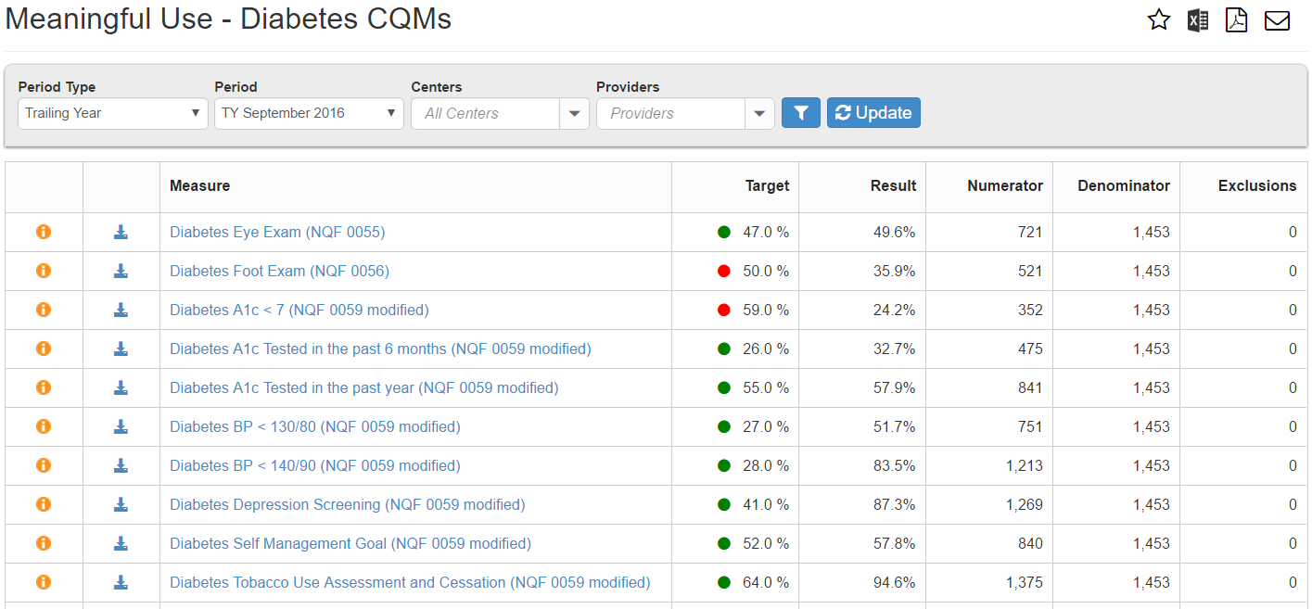
Reports & Scorecards
Reports typically displayed as a Scorecard include
Target (%)
Result (%)
Numerator
Denominator
Exclusions
Measure
Stoplight Grade

Slide 45
Reports & Scorecards
Measures highlighted in blue are clickable links that allow the ability to drill down into Measure Analyzer
Information buttons found throughout the system give more specific information about the measure or data
Supporting detail behind each measure can be directly exported to Excel

Slide 46
Performance Management|Measure Analyzer
Trends, Benchmarks and Comparison Across Centers, Groups, Providers…

Slide 47
Measure Analyzer
CHCANYS centers currently have access to a large number of measures across
multiple categories
Similar categories as the reports and scorecards
Higher level of specificity
Clinical, Operational, Panel Management, Financial and Payer data (when available)
Access the Measure Analyzer directly from the Navigation Bar or by ‘drilling’ into Measures from Scorecard Reports

Slide 48
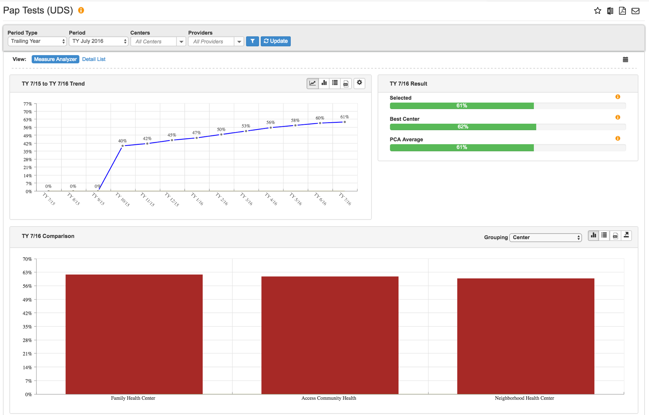
Measure Analyzer
3 Key Components
Multi-Period Trending
Benchmarks
Comparison
Charts
2
1
3

Slide 49
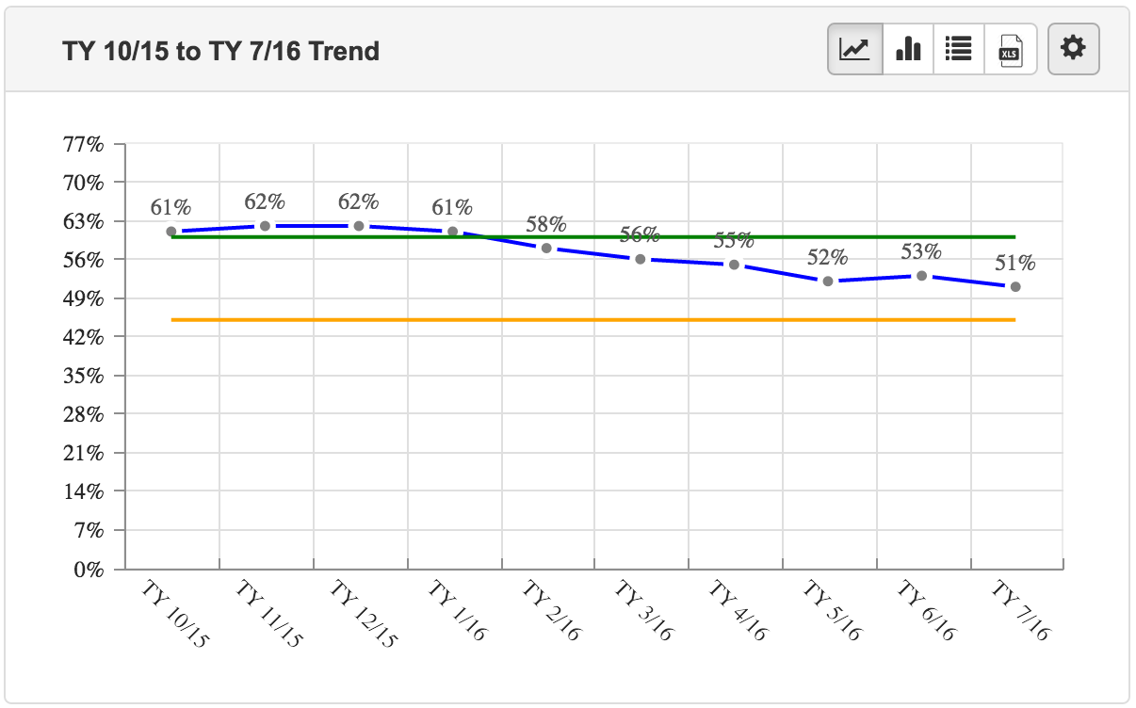
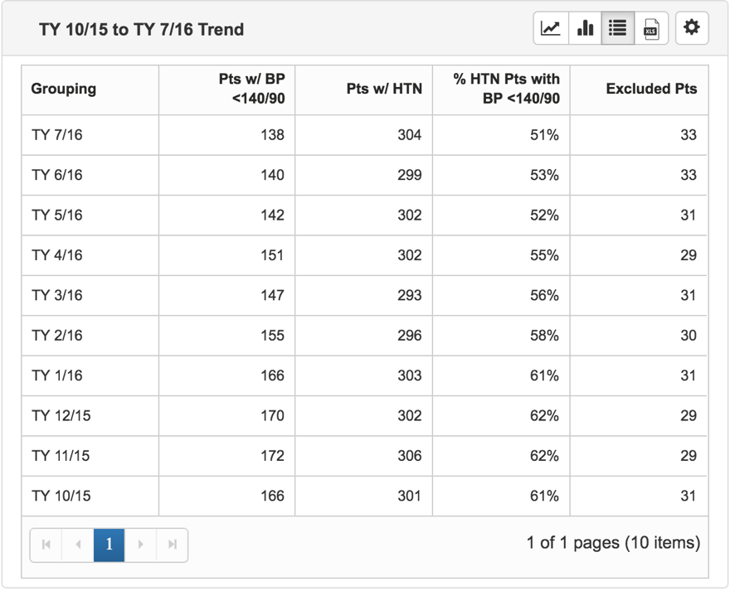
Measure Analyzer| Multi-Period Trend
Allows you to look at the measure value as a trend line over a period of time
Displays primary and secondary targets as a green and yellow lines for comparison if thresholds have been set

Slide 50
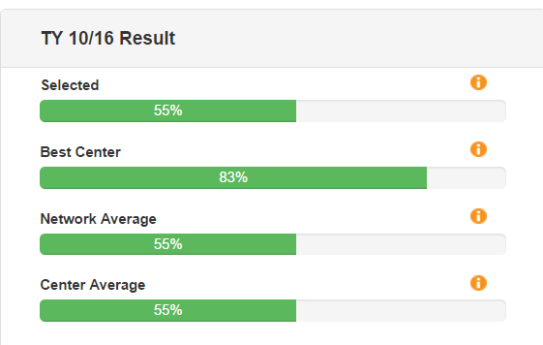
Measure Analyzer – Benchmarks
Shows the selected measure results for the most recent time period against Best and Average benchmarks
Selected: Result for filters (e.g., providers) selected
Best Center: Result for the center in the PCA with the best results
PCA Average: Average result for all centers in the PCA
Center Average: Average result for all providers at your center

Slide 51
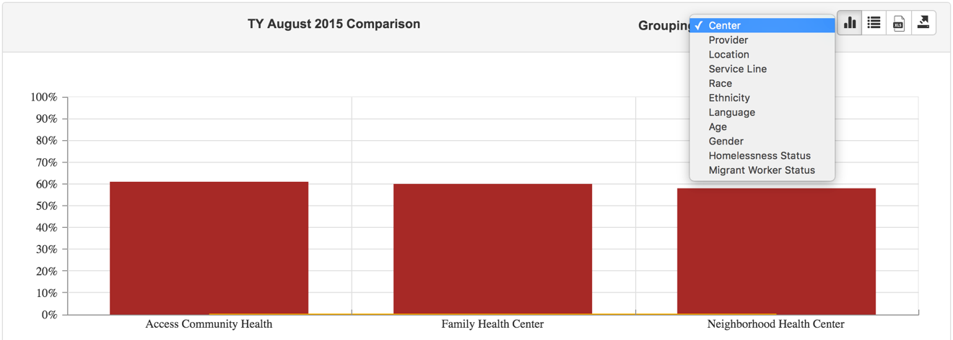
Measure Analyzer – Comparisons
Displays comparison data in chart or table form.
Clicking on the bars in the bar chart or the highlighted links in the comparison ‘drills’ down into the measure for more detail and a new Measure Analyzer is displayed.
Click to drill down to
another level

Slide 52
Performance Management| A Day in Your CHC
Measure UP!
Open up one of the scorecards
Filter by your center/site
Drill down to the measure level
How you are doing compared to others?
Drill down to details – are there patients you are concerned about?
Consider what might make a difference

Slide 53
Next Steps to Success
Notes:
CHCANYS sees this as important and so does your center

Slide 54
Who should have access to DRVS ?
Quality Director and Quality Improvement Staff
MAs / LPNs
RNs / RN Care Managers
Providers
IT / Applications Staff
Health Home Director
Behavior Health Consultants
Clinical Leadership
Executive Director and Leadership

Slide 55
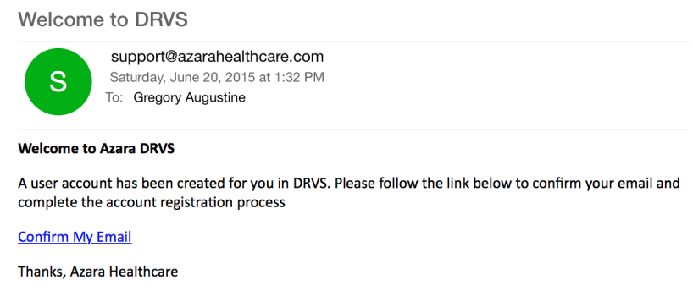
Logging In – Welcome Email
The user will
Receive an email that will guide them through account confirmation and setting their password
Confirm account within 72 hours of receiving their welcome email

Slide 56
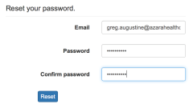
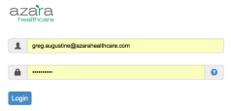
Logging In – Establishing a Password

Slide 57
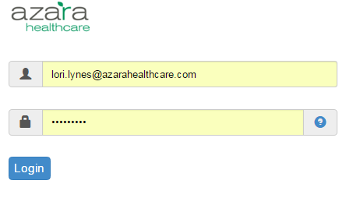
Logging In
Launch a web browser and in the address bar enter:
Example: https://DRVS.azarahealthcare.com/YOURCHC
Enter the following:
User Name: <email address>
Password: <password>
Can’t remember password – click on the Forgot Password link and enter your email

Slide 58
What Can I do Tomorrow?
Log in
Look at one of YOUR reports
Talk to leadership about how you are using CPCI
Consult with your CHCANYS Practice Facilitator – they want you to succeed
Make a plan!

Slide 59
Mark Your Calendars …
November 29, 2016 – Hands on, interactive CPCI training in NYC
Date TBD – Repeat of November 29 training session
January 10-11, 2017 - Azara is hosting our 1st ever National User Conference in Boston

Slide 60
When the winds of change blow, some people build walls, others build windmills Chinese Proverb

Slide 61
Questions & Contact Information
LuAnn Kimker rn, msn
Director of Clinical Innovation, Azara Healthcare
Luann.kimker@azarahealthcare.com

